Slide 1

Data Structures and Its Applications
Notes:
You can safely remove this slide. This slide design was provided by SlideModel.com – You can download more templates, shapes and elements for PowerPoint from http://slidemodel.com

Slide 2
UNIT – I
Data Structures: Introduction, Difference between data type and data structure, Need of Data structure, Classification of Data structures, Linear vs. Non-linear Data Structures.
Types of Data Structures in Python: Built-in and User-defined data structures.
Static Linear Data Structure: Arrays- Characteristics of an Array, Applications of Arrays. Arrays vs. List.
Searching:
Linear Search, Binary search.
Sorting:
Merge Sort, Bubble Sort, Selection Sort and Quick Sort

Slide 3
Introduction
What is Data?
The quantities, characters or symbols on which operations are performed by a computer, which may be stored or transmitted in the form of electrical signal or recorded on magnetic, optical or mechanical recording media.
Data→Information ?
aymnemsiaryus ------------------Data
I am a Students-------Information(Processed Data)
To provide appropriate way to structure the data, Data Structures is required.

Slide 4
Introduction(contnd…)
What is Data Structure?
A data structure is a way of organizing and storing data in a computer so that it can be accessed and used efficiently.
The main idea behind using data structures is to minimize the time and space complexities.
An efficient data structure takes minimum memory space and requires minimum time to execute the data.

Slide 5
Introduction(contnd…)
Data Structures are the main part of many Computer Science Algorithms as they allow the programmers to manage the data in an effective way.
It plays a crucial role in improving the performance of a program or software, as the main objective of the software is to store and retrieve the user's data as fast as possible.

Slide 6
Need of Data Structure
As applications are becoming more complex and the amount of data is increasing every day,
which may lead to problems with
1.data searching,
2.processing speed,
3.multiple requests handling and many more.
Data Structures support different methods to organize, manage, and store data efficiently.
With the help of Data Structures, we can easily traverse the data items.

Slide 7
Need of Data Structure
Eg.
Student rollnumber in 20000 pages pdf.
Case:1: all the numbers are arranged at random.
Case:2: all the numbers are arranged in an ascending order

Slide 8
Need of Data Structure
Efficient data processing: Data structures provide a way to organize and store data in a way that allows for efficient retrieval, manipulation, and storage of data.
Memory management: Proper use of data structures can help to reduce memory usage and optimize the use of resources. For example, using dynamic arrays can allow for more efficient use of memory than using static arrays.

Slide 9
Need of Data Structure
3. Code reusability: Data structures can be used as building blocks in various algorithms and programs, making it easier to reuse code.
4. Abstraction: Data structures provide a level of abstraction that allows programmers to focus on the logical structure of the data and the operations that can be performed on it, rather than on the details of how the data is stored and manipulated.
5. Algorithm design: Many algorithms rely on specific data structures to operate efficiently. Understanding data structures is crucial for designing and implementing efficient algorithms.

Slide 10
Why should we learn Data Structures?
Data Structures and Algorithms are two of the key aspects of Computer Science.
Data Structures allow us to organize and store data, whereas Algorithms allow us to process that data meaningfully.
Learning Data Structures and Algorithms will help us become better Programmers.
We will be able to write code that is more effective and reliable.
We will also be able to solve problems more quickly and efficiently

Slide 11
Applications:
2D Arrays →image Processing, Sudoku, Chess.
Stack → redo, undo, browsing history, call history
Queue →Circular queue-switch bw apps,FCFS, printer que.
Linked list →previous page, next page (browser)
Double LL →music player(previous song, next song), gallery(prev.img,next img)
Graph →fb, linkedin, social networking sites(users),fb graph api, googles knowledge api, google maps, yahoo and apple maps uses graphs to show the shortest path using BFS algo.
Tree →Representation file structure in File explorer, auto suggestion, decision based ML.

Slide 12


Slide 13
Data type | Data structure
A data type is a classification of data that defines the type of value that a variable can hold. In other words, it is a way to specify the data type that a variable can store. | A Data structure is a collection of data of similar or different data types. This collection of data can be represented using an object and can be used throughout the program.
The implementation of data type is known as an abstract implementation. | The implementation of data structure is known as a concrete implementation.
It can hold value but not data. Therefore, we can say that it is data-less. | It can hold multiple types of data within a single object.
In case of data type, a value can be assigned directly to the variables. | In the case of data structure, some operations are used to assign the data to the data structure object.
`There is no problem in the time complexity. | When we deal with a data structure object, time complexity plays an important role.
The examples of data type are int, float, char. | The examples of data structure are arrays, Linked lists, stack, queue, tree, graph.

Slide 14
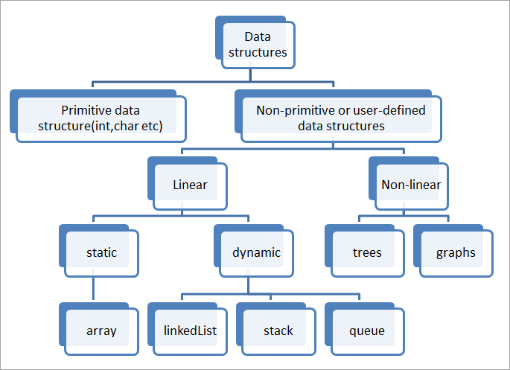
Classification of data structures

Slide 15
Classification of data structures
Data Structures are normally divided into two broad categories:
(1) Primitive Data Structures
(2) Non-Primitive Data Structures

Slide 16
Classification of data structures
Primitive Data Structures
Primitive Data Structures are the data structures consisting of the numbers and the characters that come in-built into programs.
These data structures can be manipulated or operated directly by machine-level instructions.
Ex: Integer, Float, Character, and Boolean etc.
These data types are also called Simple data types, as they contain characters that can't be divided further.

Slide 17
Classification of data structures
Non-Primitive Data Structures
Non-Primitive Data Structures are the complex data structures which are derived from Primitive Data Structures.
These data structures can't be manipulated or operated directly by machine-level instructions.
The focus of these data structures is on forming a set of data elements that is either homogeneous (same data type) or heterogeneous (different data types).

Slide 18
Non-Primitive Data Structures
The choice of data structure depends on the problem to be solved and the operations to be performed on the data.
Different data structures have different strengths and weaknesses and are suitable for different scenarios.
Understanding the different types of data structures and their characteristics is important for efficient algorithm design and implementation.

Slide 19
Non-Primitive Data Structures
Based on the structure and arrangement of data, data structures are divided into two sub-categories -
1. Linear Data Structures
2. Non-Linear Data Structures

Slide 20
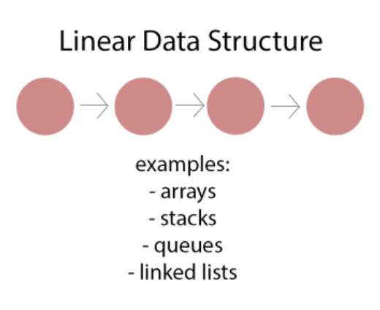
Non-Primitive Data Structures
Linear Data Structures:
A data structure that preserves a linear connection among its data elements is known as a Linear Data Structure.
The arrangement of the data is done linearly, where each element consists of unique successors and predecessors except the first and the last data element.
However, it is not necessarily true in the case of memory, as the arrangement may not be sequential.
Linear data structures are one-dimensional and can be traversed sequentially from the first to the last element.
Ex: Arrays, lists, stack, queue, etc.

Slide 21
Non-Primitive Data Structures
Based on memory allocation, the Linear Data Structures are further classified into two types:
1. Static Data Structure
2. Dynamic Data Structure

Slide 22
Linear Data Structures
Static Data Structures:
The data structures having a fixed size are known as Static Data Structures. The memory for these data structures is allocated at the compiler time, and their size cannot be changed by the user after being compiled;
However, the data stored in them can be altered. The Array is the best example of the Static Data Structure as they have a fixed size, and its data can be modified later.

Slide 23
Static Linear Data Structures
An array is a collection of items stored at contiguous memory locations
The idea is to store multiple items of the same type together
Arrays are used to store multiple values in one single variable
Arrays can be multidimensional, and all elements in an array need to be of the same type, all integers or all floats
A user can treat lists as arrays.
Most of the data structures make use of arrays to implement their algorithms. Following are the important terms to understand the concept of Array.
Element− Each item stored in an array is called an element.
Index − Each location of an element in an array has a numerical index, which is used to identify the element.

Slide 24
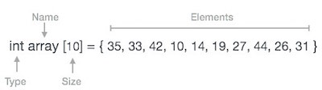
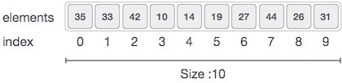
Arrays
Array Representation
Arrays can be declared in various ways in different languages. Below is an illustration.
As per the above illustration, following are the important points to be considered.
Index starts with 0.
Array length is 10 which means it can store 10 elements.
Each element can be accessed via its index. For example, we can fetch an element at index 6 as 9.

Slide 25
Static Linear Data Structures(Contd…)
Arrays can be classified into different types:
One-Dimensional Array: An Array with only one row of data elements is known as a One-Dimensional Array. It is stored in ascending storage location.
Two-Dimensional Array: An Array consisting of multiple rows and columns of data elements is called a Two-Dimensional Array. It is also known as a Matrix.
Multidimensional Array: We can define Multidimensional Array as an Array of Arrays. Multidimensional Arrays are not bounded to two indices or two dimensions as they can include as many indices are per the need.

Slide 26
Arrays
Basic Operations
Following are the basic operations supported by an array.
Traverse − print all the array elements one by one.
Insertion − Adds an element at the given index.
Deletion − Deletes an element at the given index.
Search − Searches an element using the given index or by the value.
Update − Updates an element at the given index.

Slide 27
Arrays
Advantages
In an array, accessing an element is very easy by using the index number.
The search process can be applied to an array easily
2D Array is used to represent matrices
For any reason a user wishes to store multiple values of similar type then the Array can be used and utilized efficiently
Disadvantages
Array size is fixed
Array is homogeneous - only one type of value can be store in the array (eg..int)
Array is Contiguous blocks of memory
Insertion and deletion are not easy in Array

Slide 28
Arrays
Python Lists Vs array Module as Arrays
We can treat lists as arrays. However, we cannot constrain the type of elements stored in a list.
For example:
a = [1, 3.5, "Hello"]
If you create arrays using array module, all elements of the array must be of the same numeric type.
import array as arr
a = arr.array('d', [1, 3.5, "Hello"]) // Error

Slide 29
Arrays
Creating an Array
Array is created in Python by importing array module to the python program.
Then the array is declared as shown below.
from array import *
arrayName = array(typecode, [Initializers])
or
import array
arrayName = array.array(type code, [array,items])

Slide 30
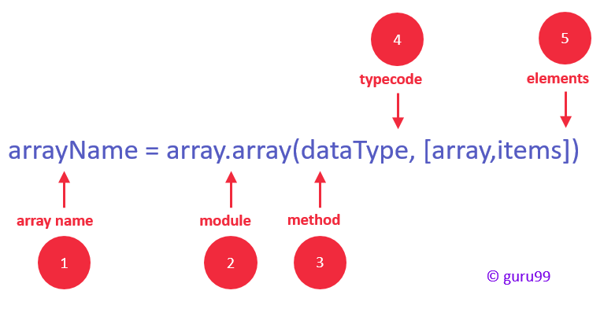
Arrays
Array Syntax
Identifier: specify a name like usually, you do for variables
Module: Python has a special module for creating array in Python, called "array" – you must import it before using it
Method: the array module has a method for initializing the array. It takes two arguments, type code, and elements.
Type Code: specify the data type using the type codes available (see list below)
Elements: specify the array elements within the square brackets, for example [130,450,103]

Slide 31
Arrays
Type code | C Type | Python Type | Minimum size in bytes
'b' | signed char | int | 1
'B' | unsigned char | int | 1
'u' | Py_UNICODE | Unicode character | 2
'h' | signed short | int | 2
'H' | unsigned short | int | 2
'i' | signed int | int | 2
'I' | unsigned int | int | 2
'l' | signed long | int | 4
'L' | unsigned long | int | 4
'f' | float | float | 4
'd' | double | float | 8
Typecode are the codes that are used to define the type of value the array will hold. Some common typecodes used are

Slide 32
Arrays
Creating Array
lets create and print an array using python.
from array import *
array1 = array('i', [10,20,30,40,50]) #array method
for x in array1:
print(x)
Accessing Array Element
We can access each element of an array using the index of the element.
The below code shows how
from array import *
array1 = array('i', [10,20,30,40,50])
print (array1[0])
print (array1[2])

Slide 33
Arrays
Insertion Operation
Insert operation is to insert one or more data elements into an array.
Based on the requirement, a new element can be added at the beginning, end, or any given index of array.
Here, we add a data element at the middle of the array using the python in-built insert() method.
from array import *
array1 = array('i', [10,20,30,40,50])
array1.insert(1,60) # arrayName.insert(index, value)
for x in array1:
print(x)
append() is also used to add the value mentioned in its arguments at the end of the array.
array1.append(70)

Slide 34
Arrays
We can add one item to a list using append() method or add several items using extend()method.
import array as arr
numbers = arr.array('i', [1, 2, 3])
numbers.append(4)
print(numbers) # Output: array('i', [1, 2, 3, 4])
# extend() appends iterable to the end of the array
numbers.extend([5, 6, 7])
print(numbers) # Output: array('i', [1, 2, 3, 4, 5, 6, 7])

Slide 35
Arrays
We can concatenate two arrays using + operator.
import array as arr
odd = arr.array('i', [1, 3, 5])
even = arr.array('i', [2, 4, 6])
numbers = arr.array('i') # creating empty array of integer
numbers = odd + even
print(numbers)

Slide 36
Arrays
Deletion Operation
Deletion refers to removing an existing element from the array and re-organizing all elements of an array.
Here, we remove a data element at the middle of the array using the python in-built remove() method.
from array import *
array1 = array('i', [10,20,30,40,50])
array1.remove(40) #You can also use the 'del' statement of Python. Del array1[index]
for x in array1:
print(x)
Error arises if element doesn’t exist in the set
pop() function can also be used to remove and return an element from the array, but by default it
removes only the last element of the array, to remove element from a specific position of the array,
index of the element is passed as an argument to the pop() method.

Slide 37
Arrays
Deletion Operation
We can delete one or more items from an array using Python's del statement.
import array as arr
number = arr.array('i', [1, 2, 3, 3, 4])
del number[2] # removing third element
print(number) # Output: array('i', [1, 2, 3, 4])
del number # deleting entire array
print(number) # Error: array is not defined

Slide 38
Arrays
Search Operation
You can perform a search for an array element based on its value or its index.
Here, we search a data element using the python in-built index() method.
from array import *
array1 = array('i', [10,20,30,40,50])
print (array1.index(40))
it produces the following result which shows the index of the element.
If the value is not present in the array then the program returns an error.

Slide 39
Arrays
Update Operation
Update operation refers to updating an existing element from the array at a given index.
Here, we simply reassign a new value to the desired index we want to update.
from array import *
array1 = array('i', [10,20,30,40,50])
array1[2] = 80
for x in array1:
print(x)

Slide 40
Arrays
How to change or add elements?
Arrays are mutable; their elements can be changed in a similar way like lists.
import array as arr
numbers = arr.array('i', [1, 2, 3, 5, 7, 10])
# changing first element
numbers[0] = 0
print(numbers) # Output: array('i', [0, 2, 3, 5, 7, 10])
# changing 3rd to 5th element
numbers[2:5] = arr.array('i', [4, 6, 8])
print(numbers) # Output: array('i', [0, 2, 4, 6, 8, 10])

Slide 41
Arrays
Slicing of a Array
There are multiple ways to print the whole array with all the elements, but to print a specific range of elements from the array, we use Slice operation.
Slice operation is performed on array with the use of colon(:).
To print elements from beginning to a range use [:Index]
to print elements from end use [:-Index]
to print elements from specific Index till the end use [Index:]
to print elements within a range, use [Start Index:End Index] and
to print whole List with the use of slicing operation, use [:].
Further, to print whole array in reverse order, use [::-1].

Slide 42
Arrays
import array as arr
numbers_list = [2, 5, 62, 5, 42, 52, 48, 5]
numbers_array = arr.array('i', numbers_list)
print(numbers_array[2:5]) # 3rd to 5th
print(numbers_array[:-5]) # beginning to 4th
print(numbers_array[5:]) # 6th to end
print(numbers_array[:]) # beginning to end

Slide 43
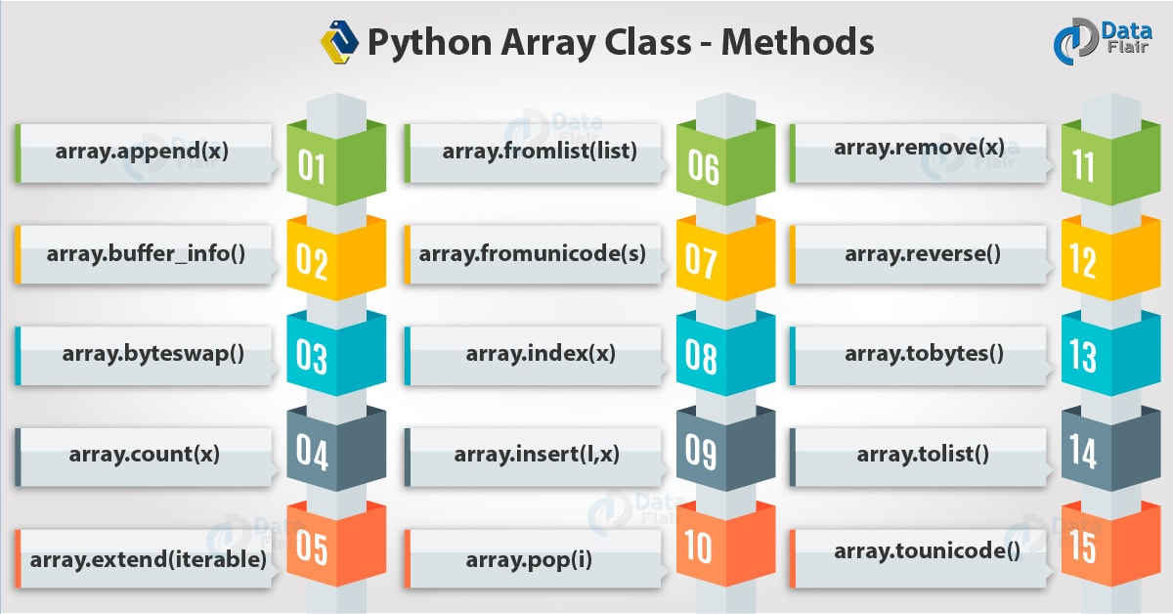
Arrays

Slide 44
Arrays
Types of arrays
One dimensional
Two Dimensional
Multi Dimensional

Slide 45
Arrays
Two dimensional array is an array within an array.
It is an array of arrays.
In this type of array the position of an data element is referred by two indices instead of one.
Consider the example of recording temperatures 4 times a day, every day.
Some times the recording instrument may be faulty and we fail to record data.
Day 1 - 11 12 5 2
Day 2 - 15 6 10
Day 3 - 10 8 12 5
Day 4 - 12 15 8 6
T = [[11, 12, 5, 2], [15, 6,10], [10, 8, 12, 5], [12,15,8,6]]
from array import *
T = [[11, 12, 5, 2], [15, 6,10], [10, 8, 12, 5], [12,15,8,6]]
print(T[0])
print(T[1][2])

Slide 46
Arrays
To print out the entire two dimensional array we can use python for loop as shown below.
We use end of line to print out the values in different rows.
from array import *
T = [[11, 12, 5, 2], [15, 6,10], [10, 8, 12, 5], [12,15,8,6]]
for r in T:
for c in r:
print(c,end = " ")
print()
Inserting Values in Two Dimensional Array
T.insert(2, [0,5,11,13,6])
Updating Values in Two Dimensional Array
T[2] = [11,9] T[0][3] = 7

Slide 47
Arrays
Here are few more examples related to Python matrices using nested lists.
Add two matrix
X = [[12,7,3],
[4 ,5,6],
[7 ,8,9]]
Y = [[5,8,1],
[6,7,3],
[4,5,9]]
result = [[0,0,0],
[0,0,0],
[0,0,0]]
# iterate through rows
for i in range(len(X)):
# iterate through columns
for j in range(len(X[0])):
result[i][j] = X[i][j] + Y[i][j]
for r in result:
print(r)

Slide 48
Arrays
# Program to transpose a matrix using nested loop
X = [[12,7], [4 ,5], [3 ,8]]
result = [[0,0,0],
[0,0,0]]
# iterate through rows
for i in range(len(X)):
# iterate through columns
for j in range(len(X[0])):
result[j][i] = X[i][j]
for r in result:
print(r)

Slide 49
Arrays
# Program to multiply two matrices using nested loops
# 3x3 matrix
X = [[12,7,3], [4 ,5,6], [7 ,8,9]]
# 3x4 matrix
Y = [[5,8,1,2], [6,7,3,0], [4,5,9,1]]
# result is 3x4
result = [[0,0,0,0],[0,0,0,0],[0,0,0,0]]
# iterate through rows of X
for i in range(len(X)):
# iterate through columns of Y
for j in range(len(Y[0])):
# iterate through rows of Y
for k in range(len(Y)):
result[i][j] += X[i][k] * Y[k][j]
for r in result:
print(r)

Slide 50
SEARCHING
Types of Searching
Unordered Linear Search
Sorted/Ordered Linear Search
Binary Search
SORTING Techniques
classifying sorting algorithms
Internal Sort
External Sort
Types of Sortings
Bubble Sort
Insertion Sort
Selection Sort
Merge Sort
Quick Sort

Slide 51
Searching
What is Searching?
In computer science, searching is the process of finding an item with specified properties from a collection of items.
The items may be stored as records in a database, simple data elements in arrays, text in files, nodes in trees, vertices and edges in graphs, or they may be elements of other search spaces.
Why do we need Searching?
We know that today’s computers store a lot of information. To retrieve this information proficiently we need very efficient searching algorithms.
There are certain ways of organizing the data that improves the searching process.
That means, if we keep the data in proper order, it is easy to search the required element.
Sorting and Searching is one of the techniques for making the elements ordered.
Notes:
https://www.cs.usfca.edu/~galles/visualization/Search.html

Slide 52
Searching
Types of Searching
Following are the types of searches.
• Unordered Linear Search
• Sorted/Ordered Linear Search
• Binary Search
• Symbol Tables and Hashing
• String Searching Algorithms: Tries, Ternary Search and Suffix Trees
Notes:
https://www.cs.usfca.edu/~galles/visualization/Search.html

Slide 53
Searching
A search traverses the collection until
The desired element is found
Or the collection is exhausted
If the collection is ordered, I might not have to look at all elements
I can stop looking when I know the element cannot be in the collection.
Notes:
https://www.cs.usfca.edu/~galles/visualization/Search.html

Slide 55
Linear Search

Slide 56
Linear Search
my_array
7
12
5
22
13
32
target = 13
1
2
3
4
5
6
my_array
7
12
5
22
13
32
target = 13
1
2
3
4
5
6
my_array
7
12
5
22
13
32
target = 13
1
2
3
4
5
6
my_array
7
12
5
22
13
32
target = 13
1
2
3
4
5
6
Notes:
https://www.cs.usfca.edu/~galles/visualization/Search.html

Slide 57
Linear Search
my_array
7
12
5
22
13
32
target = 13
1
2
3
4
5
6
my_array
7
12
5
22
13
32
target = 13
1
2
3
4
5
6
Target data found
Notes:
https://www.cs.usfca.edu/~galles/visualization/Search.html

Slide 58
Linear Search
Unordered Linear Search
Let us assume we are given an array where the order of the elements is not known.
That means the elements of the array are not sorted.
In this case, to search for an element we have to scan the complete array and see if the element is there in the given list or not.
def UnOrderedLinearSearch (numbersList, value):
for i in range(len(numbersList)):
if numbersList[i] == value:
return i
return -1
A= [534,246,933,127,277,321,454,565,220]
print(UnOrderedLinearSearch(A,277))
Notes:
https://www.cs.usfca.edu/~galles/visualization/Search.html

Slide 59
Flowchart: Sequential Search with Array

Slide 60
Linear Search
def UnOrderedLinearSearch (numbersList, value):
for i in range(len(numbersList)):
if numbersList[i] == value:
return i
return -1
A=[534,246,933,127,277,321,454,565,220]
print("The elements are:", A)
key=int(input("Enter the element to be searched:"))
status=UnOrderedLinearSearch(A,key)
if(status!=-1):
print("Element found at %i location" %status)
else:
print("Element not found in the list")
Notes:
https://www.cs.usfca.edu/~galles/visualization/Search.html

Slide 61
Linear Search
Sorted/Ordered Linear Search
If the elements of the array are already sorted, then in many cases we don't have to scan the complete array to see if the element is there in the given array or not.
In the algorithm below, it can be seen that, at any point if the value at A[i] is greater than the data to be searched, then we just return - 1 without searching the remaining array.
def OrderedLinearSearch (numbersList, value):
for i in range(len(numbersList)):
if numbersList[i] == value:
return i
elif numbersList[i] > value:
return
return – 1
A= [34,46,93,127,277,321,454,565,1220]
print(OrderedLinearSearch(A,565))
Notes:
https://www.cs.usfca.edu/~galles/visualization/Search.html

Slide 62
Linear Search
Worst Case:
N comparisons
Linear Search Analysis: Worst Case
Linear Search Analysis: Best Case
Worst Case: match with the last item (or no match)
7
12
5
22
13
32
target = 32
Best Case:
1 comparison
Best Case: match with the first item
7
12
5
22
13
32
target = 7
Notes:
https://www.cs.usfca.edu/~galles/visualization/Search.html

Slide 63
Complexity Analysis
Case 1: The key matches with the first element
T(n) = 1
Case 2: Key does not exist
T(n) = n
Case 3: The key is present at any location in the array

Slide 64
Complexity Analysis : Summary
Case | Number of key comparisons | Asymptotic complexity | Remark
Case 1 | T(n) = 1 | T(n) = O(1) | Best case
Case 2 | T(n) = n | T(n) = O(n) | Worst case
Case 3 |  | T(n) = O(n) | Average case

Slide 65
Linear Search
Of course we could use our simpler search and traverse the array
But we can use the fact that the array is sorted to our advantage
This will allow us to reduce the number of comparisons
Notes:
https://www.cs.usfca.edu/~galles/visualization/Search.html

Slide 66
Linear Search
Built in Functions
A=[534,246,933,127,277,321,454,565,220]
print("The elements are:", A)
key=int(input("Enter the element to be searched:"))
try:
status=A.index(key)
print("Element found at",status,"location")
except:
print("Element not found in the list")
A=[534,246,933,127,277,321,454,565,220]
print("The elements are:", A)
key=int(input("Enter the element to be searched:"))
status=A.count (key)
if(status!=0):
print("Element found at",status,"location")
else:
print("Element not found in the list")
Notes:
https://www.cs.usfca.edu/~galles/visualization/Search.html

Slide 67
Binary Search

Slide 68
Binary Search
Let us consider the problem of searching a word in a dictionary.
Typically, we directly go to some approximate page [say, middle page] and start searching from that point.
If the name that we are searching is the same then the search is complete.
If the page is before the selected pages then apply the same process for the first half;
otherwise apply the some process to the second half.
Binary search also works in the same way.
The algorithm applying such a strategy is referred to as binary search algorithm.
Requires a sorted array or a binary search tree.
Cuts the “search space” in half each time.
Keeps cutting the search space in half until the target is found or has exhausted the all possible locations.
Notes:
https://www.cs.usfca.edu/~galles/visualization/Search.html

Slide 69
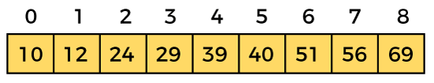
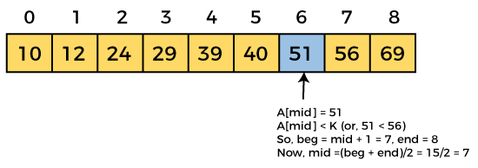
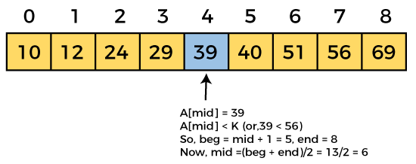
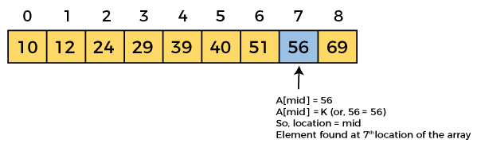
Example:
Let the elements of array are -
Step 3:
Step 1:
Let the element to search is, K = 56
We have to use the below formula to calculate the mid of the array –
mid = (beg + end)/2
beg = 0
end = 8
mid = (0 + 8)/2 = 4. So, 4 is the mid of the array.
Step 2:
Step 4:
Now, the element to search is found. So algorithm will return the index of the element matched.

Slide 70
The Technique

Slide 71
Flowchart: Binary Search with Array

Slide 72
Algorithm
Binary_Search(a, lower_bound, upper_bound, val) // 'a' is the given array, 'lower_bound' is the index of the first array element, 'upper_bound' is the index of the last array element, 'val' is the value to search
Step 1: set beg = lower_bound, end = upper_bound, pos = - 1
Step 2: repeat steps 3 and 4 while beg <=end
Step 3: set mid = (beg + end)/2
Step 4: if a[mid] = val
set pos = mid
print pos
go to step 6
else if a[mid] > val
set end = mid - 1
else
set beg = mid + 1
[end of if]
[end of loop]
Step 5: if pos = -1
print "value is not present in the array"
[end of if]
Step 6: exit

Slide 73
There are two methods to implement the binary search algorithm –
Iterative method
Recursive method

Slide 74
Binary Search Algorithm: Program
#Iterative Binary Search Algorithm
def BinarySearchIterative(numbersList, value):
low = 0
high = len(numbersList)-1
while low <= high:
mid =(low+high)//2
if numbersList[mid] > value:
high = mid-1
elif numbersList[mid] <value:
low= mid+1
else:
return mid
return -1
A =[534,246,933,127,277,321,454,565,220]
key=int(input("Enter the element to be searched:"))
status=BinarySearchIterative(A,key)
if(status!=-1):
print("Element found at %i location" %status)
else:
print("Element not found in the list")
Notes:
https://www.cs.usfca.edu/~galles/visualization/Search.html

Slide 75
#Recursive Binary Search Algorithm
def BinarySearchRecursive(numbersList, value, low= 0, high= -1):
if not numbersList: return -1
if(high == -1): high = len(numbersList)- 1
if low == high:
if numbersList[low] == value: return low
else: return - 1
mid=low + (high-low)//2
if numbersList[mid] >value: return BinarySearchRecursive(numbersList, value, low, mid-1)
elif numbersList[mid] < value: return BinarySearchRecursive(numbersList, value, mid+ 1, high)
else: return mid
A=[534,246,933,127,277,321.454,565,220]
print(BinarySearchRecursive(A,277))
Notes:
https://www.cs.usfca.edu/~galles/visualization/Search.html

Slide 76
Time Complexity
Case | Time Complexity
Best Case | O(1)
Average Case | O(logn)
Worst Case | O(logn)
Space Complexity
Space Complexity | O(1)

Slide 77

How many comparisons??
Binary Search Analysis: Worst Case
Worst Case: divide until reach one item, or no match.
Notes:
https://www.cs.usfca.edu/~galles/visualization/Search.html

Slide 78
Binary Search Algorithm
Binary Search Analysis: Worst Case
With each comparison we throw away ½ of the list
N
…………
1 comparison
N/2
…………
1 comparison
Number of steps is at
most ➔Log₂N
N/4
…………
1 comparison
N/8
…………
1 comparison
.
.
.
1
…………
1 comparison
Notes:
https://www.cs.usfca.edu/~galles/visualization/Search.html

Slide 79
Binary Search Algorithm
Binary Search Analysis: Best Case
Best Case:
1 comparison
Best Case: match from the firs comparison
1 7 9 12 33 42 59 76 81 84 91 92 93 99
Target: 59
Notes:
https://www.cs.usfca.edu/~galles/visualization/Search.html

Slide 80
Binary Search Algorithm
Binary search reduces the work by half at each comparison
If array is not sorted ➔ Linear Search
Best Case O(1)
Worst Case O(N)
If array is sorted ➔ Binary search
Best Case O(1)
Worst Case O(Log₂N)
Notes:
https://www.cs.usfca.edu/~galles/visualization/Search.html

Slide 81
Sorting
Sorting: an operation that segregates items into groups according to specified criterion.
A = { 3 1 6 2 1 3 4 5 9 0 }
A = { 0 1 1 2 3 3 4 5 6 9 }
Sorting = ordering.
Sorted = ordered based on a particular way.
Generally, collections of data are presented in a sorted manner.
Examples of Sorting:
Words in a dictionary are sorted (and case distinctions are ignored).
Files in a directory are often listed in sorted order.
The index of a book is sorted (and case distinctions are ignored).
Notes:
https://www.cs.usfca.edu/~galles/visualization/Search.html

Slide 82
Sorting
Many banks provide statements that list checks in increasing order (by check number).
In a newspaper, the calendar of events in a schedule is generally sorted by date.
Musical compact disks in a record store are generally sorted by recording artist.
Why Sorting required?
Imagine finding the phone number of your friend in your mobile phone, but the phone book is not sorted.
Notes:
https://www.cs.usfca.edu/~galles/visualization/Search.html

Slide 83
Sorting
Most of the primary sorting algorithms run on different space and time complexity.
Time Complexity is defined to be the time the computer takes to run a program (or algorithm in our case).
Space complexity is defined to be the amount of memory the computer needs to run a program.
Notes:
https://www.cs.usfca.edu/~galles/visualization/Search.html

Slide 84
Sorting
Types of Sorting Algorithms
There are many, many different types of sorting algorithms, but the primary ones are:
Bubble Sort
Selection Sort
Insertion Sort
Merge Sort
Quick Sort
Shell Sort
Radix Sort
Heap Sort
Bucket Sort
Notes:
https://www.cs.usfca.edu/~galles/visualization/Search.html

Slide 85
Sorting
Classification of Sorting Algorithms
Sorting algorithms arc generally categorized based on the following parameters.
By Number of Comparisons
By Number of Swaps
By Memory Usage
By Recursion
By Adaptability
Another method of c classifying sorting algorithms is:
• Internal Sort
• External Sort
Notes:
https://www.cs.usfca.edu/~galles/visualization/Search.html

Slide 86
Sorting
Internal Sort
Sort algorithms that use main memory exclusively during the sort are called internal sorting algorithms. This kind of algorithm assumes high-speed random access to all memory.
External Sort
Sorting algorithms that use external memory, such as tape or disk, during the sort come under this category
Notes:
https://www.cs.usfca.edu/~galles/visualization/Search.html

Slide 87
Sorting
External sorting is required when the data being sorted do not fit into the main memory of a computing device (usually RAM) and instead they must reside in the slower external memory (usually a hard drive).
External sorting typically uses a hybrid sort-merge strategy.
In the sorting phase, chunks of data small enough to fit in main memory are read, sorted, and written out to a temporary file.
In the merge phase, the sorted sub-files are combined into a single larger file.
Notes:
https://www.cs.usfca.edu/~galles/visualization/Search.html

Slide 88
Bubble Sort
This sorting technique is also known as exchange sort.
Arranges values by iterating over the list several times and in each iteration the larger value gets bubble up to the end of the list.
This algorithm uses multiple passes and in each pass the first and second data items are compared.
If the first data item is bigger than the second, then the two items are swapped.
Next the items in second and third position are compared and if the first one is larger than the second, then they are swapped,
otherwise no change in their order.
This process continues for each successive pair of data items until all items are sorted.
Notes:
https://www.cs.usfca.edu/~galles/visualization/Search.html

Slide 89
Bubble Sort
Step-by-step example:
Let us take the array of numbers "5 1 4 2 8", and sort the array from lowest number to greatest number using bubble sort.
In each step, elements written in bold are being compared.
First Pass:
( 5 1 4 2 8 ) ( 1 5 4 2 8 ), Here, algorithm compares the first two elements, and swaps since 5 > 1.
( 1 5 4 2 8 ) ( 1 4 5 2 8 ), Swap since 5 > 4
( 1 4 5 2 8 ) ( 1 4 2 5 8 ), Swap since 5 > 2
( 1 4 2 5 8 )
( 1 4 2 5 8 ), Now, since these elements are already in order (8 > 5), algorithm does not swap them.
Second Pass:
( 1 4 2 5 8 ) ( 1 4 2 5 8 )
( 1 4 2 5 8 ) ( 1 2 4 5 8 ), Swap since 4 > 2
( 1 2 4 5 8 ) ( 1 2 4 5 8 )
( 1 2 4 5 8 ) ( 1 2 4 5 8 )
Notes:
https://www.cs.usfca.edu/~galles/visualization/Search.html

Slide 90
Bubble Sort
Now, the array is already sorted, but our algorithm does not know if it is completed.
The algorithm needs one whole pass without any swap to know it is sorted.
Third Pass:
( 1 2 4 5 8 ) ( 1 2 4 5 8 )
( 1 2 4 5 8 ) ( 1 2 4 5 8 )
( 1 2 4 5 8 ) ( 1 2 4 5 8 )
( 1 2 4 5 8 ) ( 1 2 4 5 8 )
Notes:
https://www.cs.usfca.edu/~galles/visualization/Search.html

Slide 91
Bubble Sort
Bubble Sort Algorithm:
Step 1: Repeat Steps 2 and 3 for i=1 to 10
Step 2: Set j=1
Step 3: Repeat while j<=n
(A) if a[i] < a[j]
Then interchange a[i] and a[j]
[End of if]
(B) Set j = j+1
[End of Inner Loop]
[End of Step 1 Outer Loop]
Step 4: Exit
Notes:
https://www.cs.usfca.edu/~galles/visualization/Search.html

Slide 92
Bubble Sort
Sort the given elements
1st Pass details
Notes:
https://www.cs.usfca.edu/~galles/visualization/Search.html

Slide 93
Bubble Sort
def BubbleSort( A ):
for i in range( len( A) ):
for k in range( len( A) - 1, i, - 1 ):
if ( A[k] < A[k - 1 ] ):
swap(A,k,k-1)
def swap( A, x, y ):
temp= A[x]
A[x] = A[y]
A[y] = temp
A= [534,246,933, 127,277,321,454,565,220]
BubbleSort(A)
print( A)
Notes:
https://www.cs.usfca.edu/~galles/visualization/Search.html

Slide 94
Bubble Sort
def bubbleSort(arr):
n = len(arr)
swapped = False
for i in range(n-1):
for j in range(0, n-i-1):
if arr[j] > arr[j + 1]:
swapped = True
arr[j], arr[j + 1] = arr[j + 1], arr[j]
if not swapped:
return
# Driver code to test above
arr = [64, 34, 25, 12, 22, 11, 90]
bubbleSort(arr)
print("Sorted array is:" , arr)
Notes:
https://www.cs.usfca.edu/~galles/visualization/Search.html

Slide 95
Time & Space Complexity
Worst and Average Case Time Complexity: O(n*n). Worst case occurs when array is reverse sorted. Best Case Time Complexity: O(n). Best case occurs when array is already sorted. Space Complexity: O(1)

Slide 96
Selection Sort
Selection sort algorithm is one of the simplest sorting algorithm, which sorts the elements in an array by finding the minimum element in each pass from unsorted part and keeps it in the beginning.
This sorting technique improves over bubble sort by making only one exchange in each pass.
This sorting technique maintains two sub arrays, one sub array which is already sorted and the other one which is unsorted.
In each iteration the minimum element (ascending order) is picked from unsorted array and moved to sorted sub array
Notes:
https://www.cs.usfca.edu/~galles/visualization/Search.html

Slide 97
Selection Sort
Step-by-step example:
Here is an example of this sort algorithm sorting five elements:
64 25 12 22 11
1st Pass: 11 25 12 22 64
2nd Pass: 11 12 25 22 64
3rd Pass: 11 12 22 25 64
4th Pass: 11 12 22 25 64
Notes:
https://www.cs.usfca.edu/~galles/visualization/Search.html

Slide 98
Selection Sort
Selection Sort Algorithm:
Notes:
https://www.cs.usfca.edu/~galles/visualization/Search.html

Slide 99
Selection Sort
Selection sort is an in-place sorting algorithm.
Selection sort works well for small files.
It is used for sorting the files with very large values and small keys.
This is because selection is made based on keys and swaps are made only when required.
Advantages
• Easy to implement
• In-place sort (requires no additional storage space)
Algorithm
l. Find the minimum value in the list
2. Swap it with the value in the current position
3. Repeat this process for all the elements until the entire array is sorted
This algorithm is called selection sort since it repeatedly selects the smallest element.
Notes:
https://www.cs.usfca.edu/~galles/visualization/Search.html

Slide 100
Selection Sort
def SelectionSort( A ):
for i in range( len( A ) ):
least = i
for k in range( i + 1 , len( A)):
if A[k] < A[least]:
least = k
swap( A, least, i )
def swap( A, x, y ):
temp= A[x]
A[x] = A[y]
A[y] =temp
A= [54,26,93,17,77,31,44,55,20]
SelectionSort(A)
print(A)
Notes:
https://www.cs.usfca.edu/~galles/visualization/Search.html

Slide 101
Time & Space Complexity: Selection Sort
Worst Case Time Complexity [ Big-O ]: O(n²)
Best Case Time Complexity [Big-omega]: O(n²)
Average Time Complexity [Big-theta]: O(n²)
Space Complexity: O(1)

Slide 102
Merge Sort
Merge sort is based on Divide and conquer method.
It takes the list to be sorted and divide it in half to create two unsorted lists.
The two unsorted lists are then sorted and merged to get a sorted list. The two unsorted lists are sorted by continually calling the merge-sort algorithm;
We eventually get a list of size 1 which is already sorted. The two lists of size 1 are then merged.
Notes:
https://www.cs.usfca.edu/~galles/visualization/Search.html

Slide 103
Merge Sort
Merge Sort Procedure:
This works as follows :
1. Divide the input which we have to sort into two parts in the middle. Call it the left part and right part.
2. Sort each of them separately. Note that here sort does not mean to sort it using some other method.
We use the same function recursively.
3. Then merge the two sorted parts.
Notes:
https://www.cs.usfca.edu/~galles/visualization/Search.html

Slide 104
Merge Sort
Step-by-step example:
Notes:
https://www.cs.usfca.edu/~galles/visualization/Search.html

Slide 105
Merge Sort
Important Notes
Merging is the process of combining two sorted files to make one bigger sorted file.
Selection is the process of dividing a file into two parts: k smallest elements and a - k largest elements.
• Selection and merging are opposite operations
selection splits a list into two lists
merging joins two files to make one file
• Merge sort accesses the data in a sequential manner
Notes:
https://www.cs.usfca.edu/~galles/visualization/Search.html

Slide 106
Merge Sort
def MergeSort(A):
if len(A)> 1:
mid = len(A)//2
lefthalf = A[:mid]
righthalf = A[mid:]
MergeSort(lefthalf)
MergeSort(righthalf)
i=j=k=0
while i<len(lefthalf) and j<len(righthalf):
if lefthalf[i]<righthalf[j]:
A[k]=lefthalf[i]
i=i+1
else:
A[k]=righthalf[j]
j=j+1
k=k+ 1
while i<len(lefthalf):
A[k]=lefthalf[i]
i=i+1
k=k+1
while j<len(righthalf):
A[k]=righthalf[j]
j=j+1
k=k+1
A = [534,246,933, 127,277,321,454,565,220]
MergeSort(A)
print(A)
Notes:
https://www.cs.usfca.edu/~galles/visualization/Search.html

Slide 107
Quick Sort
Quick Sort Procedure:
Quicksort is a sorting algorithm based on the divide and conquer approach where
An array is divided into sub arrays by selecting a pivot element (element selected from the array). While dividing the array, the pivot element should be positioned in such a way that elements less than pivot are kept on the left side and elements greater than pivot are on the right side of the pivot.
The left and right sub arrays are also divided using the same approach. This process continues until each subarray contains a single element.
At this point, elements are already sorted. Finally, elements are combined to form a sorted array.

Slide 108
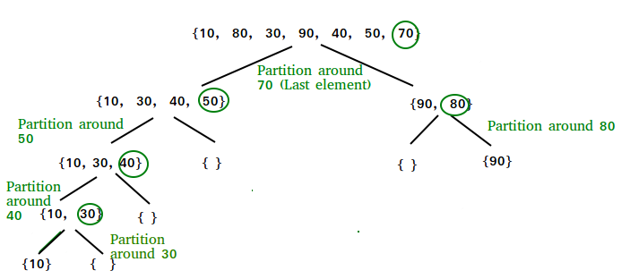
Quick Sort
1. Select the Pivot Element
There are different variations of quicksort where the pivot element is selected from different positions. Here, we will be selecting the rightmost element of the array as the pivot element.
2. Rearrange the Array
Now the elements of the array are rearranged so that elements that are smaller than the pivot are put on the left and the elements greater than the pivot are put on the right.
3. The key process in quicksort is partition
Target of partitions is, given an array and an element x of array as pivot, put x at its correct position in sorted array and put all smaller elements (smaller than x) before x, and put all greater elements (greater than x) after x. All this should be done in linear time.

Slide 109
Quick Sort
def partition(start, end, array): pivot_index = start pivot = array[pivot_index] while start < end: while start < len(array) and array[start] <= pivot: start += 1 while array[end] > pivot: end -= 1 if (start < end): array[start], array[end] = array[end], array[start] array[end], array[pivot_index] = array[pivot_index], array[end] return end
def quick_sort(start, end, array): if (start < end): p = partition(start, end, array) quick_sort(start, p - 1, array) quick_sort(p + 1, end, array) array = [10, 17, 8, 9, 16, 5] quick_sort(0, len(array) - 1, array) print(f'Sorted array: {array}')

Slide 110
www.mallareddyuniversity.ac.in
Notes:
You can safely remove this slide. This slide design was provided by SlideModel.com – You can download more templates, shapes and elements for PowerPoint from http://slidemodel.com

Slide 111
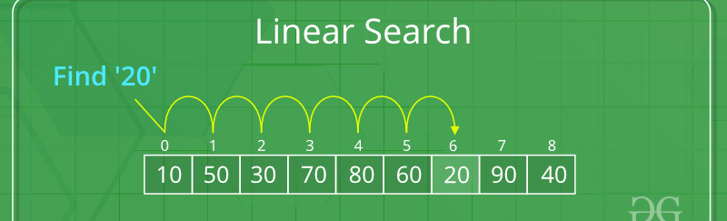
Searching Techniques
Searching Algorithms are designed to check for an element or retrieve an element from any data structure where it is stored.
Based on the type of search operation, these algorithms are generally classified into two categories:
Sequential Search: In this, the list or array is traversed sequentially and every element is checked. For example: Linear Search.

Slide 112
Linear Search Algorithm
Step 1: First, read the search element (Target element) in the array. Step 2: In the second step compare the search element with the first element in the array. Step 3: If both are matched, display “Target element is found” and terminate the Linear Search function. Step 4: If both are not matched, compare the search element with the next element in the array. Step 5: In this step, repeat steps 3 and 4 until the search (Target) element is compared with the last element of the array. Step 6 – If the last element in the list does not match, the Linear Search Function will be terminated, and the message “Element is not found” will be displayed.
Linear Search is defined as a sequential search algorithm that starts at one end and goes through each element of a list until the desired element is found, otherwise the search continues till the end of the data set. It is the easiest searching algorithm.​

Slide 113
Follow the given steps to solve the problem:
Set the first element of the array as the current element.
If the current element is the target element, return its index.
If the current element is not the target element and if there are more elements in the array, set the current element to the next element and repeat step 2.
If the current element is not the target element and there are no more elements in the array, return -1 to indicate that the element was not found.
Given an array arr[] of N elements, the task is to write a function to search a given element x in arr[].
Examples:
Input: arr[] = {10, 20, 80, 30, 60, 50,110, 100, 130, 170}, x = 110; Output: 6 Explanation: Element x is present at index 6
Input: arr[] = {10, 20, 80, 30, 60, 50,110, 100, 130, 170}, x = 175; Output: -1 Explanation: Element x is not present in arr[].

Slide 114
Linear Search Implementation
def search(arr, N, x):
for i in range(0, N):
if (arr[i] == x):
return i
return -1
# Driver Code
if __name__ == "__main__":
arr = [2, 3, 4, 10, 40]
x = 10
N = len(arr)
# Function call
result = search(arr, N, x)
if(result == -1):
print("Element is not present in array")
else:
print("Element is present at index", result)
Time complexity: O(N) Auxiliary Space: O(1)

Slide 115
Using “in” keyword in python:
The approach: we use a list instead of a vector or ArrayList, and we can use the “in” keyword to check if an element is present in the list.
v = [5, 15, 6, 9, 4] # create a list with initial values
key = 4 # variable to store the element to be searched
if key in v: # check if the element is present in the list
print(key, "is present in the list")
else:
print(key, "is not present in the list")

Slide 116
Linear Search Recursive Approach:
Follow the given steps to solve the problem:
If the size of the array is zero then, return -1, representing that the element is not found. This can also be treated as the base condition of a recursion call.
Otherwise, check if the element at the current index in the array is equal to the key or not i.e, arr[size – 1] == key
If equal, then return the index of the found key.

Slide 117
def linear_search(arr, key, size):
# If the array is empty we will return -1
if (size == 0):
return -1
elif (arr[size - 1] == key):
# Return the index of found key.
return size - 1
else:
return linear_search(arr, key, size - 1)
# Driver's code
if __name__ == "__main__":
arr = [5, 15, 6, 9, 4]
key = 4
size = len(arr)
ans = linear_search(arr, key, size) # Calling the Function
if ans != -1:
print("The element", key, "is found at",ans, "index of the given array.")
else:
print("The element", key, "is not found.")

Slide 118
Space Complexity
Space complexity for linear search is O (n) as it does not use any extra space where n is the number of elements in an array.
Time Complexity Best- case complexity = O (1) occurs when the search element is present at the first element in the search array. Worst- case complexity = O (n) occurs when the search element is not present in the set of elements or array. Average complexity = O (n) is referred to when the element is present somewhere in the search array
Time Complexity: O(N) Auxiliary Space: O(N), for using recursive stack space.

Slide 119
Advantages of Linear Search:
Linear search is simple to implement and easy to understand.
Linear search can be used irrespective of whether the array is sorted or not. It can be used on arrays of any data type.
Does not require any additional memory.
It is a well suited algorithm for small datasets.

Slide 120
Drawbacks of Linear Search:
Linear search has a time complexity of O(n), which in turn makes it slow for large datasets.
Not suitable for large array.
Linear search can be less efficient than other algorithms, such as hash tables.

Slide 121
When to use Linear Search:
When we are dealing with a small dataset.
When you need to find an exact value.
When you are searching a dataset stored in contiguous memory.
When you want to implement a simple algorithm.

Slide 122
Summary:
Linear search is a simple and flexible algorithm for finding whether an element is present within an array.
It sequentially examines each element of the array.
The time complexity of linear search is O(n).
It is used for searching databases, lists, and arrays.

Slide 123
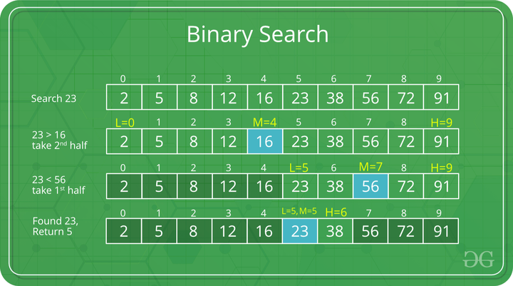
Binary Search
Interval Search: These algorithms are specifically designed for searching in sorted data-structures.
These type of searching algorithms are much more efficient than Linear Search as they repeatedly target the center of the search structure and divide the search space in half.
For Example: Binary Search.

Slide 124
Binary Search
Binary Search is a searching algorithm used in a sorted array by repeatedly dividing the search interval in half. The idea of binary search is to use the information that the array is sorted and reduce the time complexity to O(Log n).
Step-by-step Binary Search Algorithm: We basically ignore half of the elements just after one comparison.
Compare x with the middle element.
If x matches with the middle element, we return the mid index.
Else If x is greater than the mid element, then x can only lie in the right half subarray after the mid element. So we recur for the right half.
Else (x is smaller) recur for the left half.

Slide 125
Binary Search Algorithm:
The basic steps to perform Binary Search are
Sort the array in ascending order.
Set the low index to the first element of the array and the high index to the last element.
Set the middle index to the average of the low and high indices.
If the element at the middle index is the target element, return the middle index.
If the target element is less than the element at the middle index, set the high index to the middle index – 1.
If the target element is greater than the element at the middle index, set the low index to the middle index + 1.
Repeat steps 3-6 until the element is found or it is clear that the element is not present in the array.

Slide 126
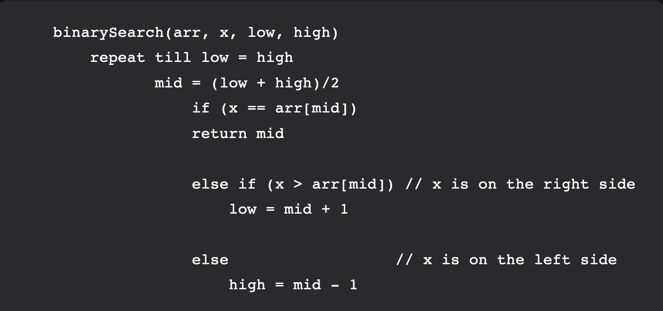
Binary Search Algorithm can be implemented in the following two ways
Iterative Method
Recursive Method

Slide 127
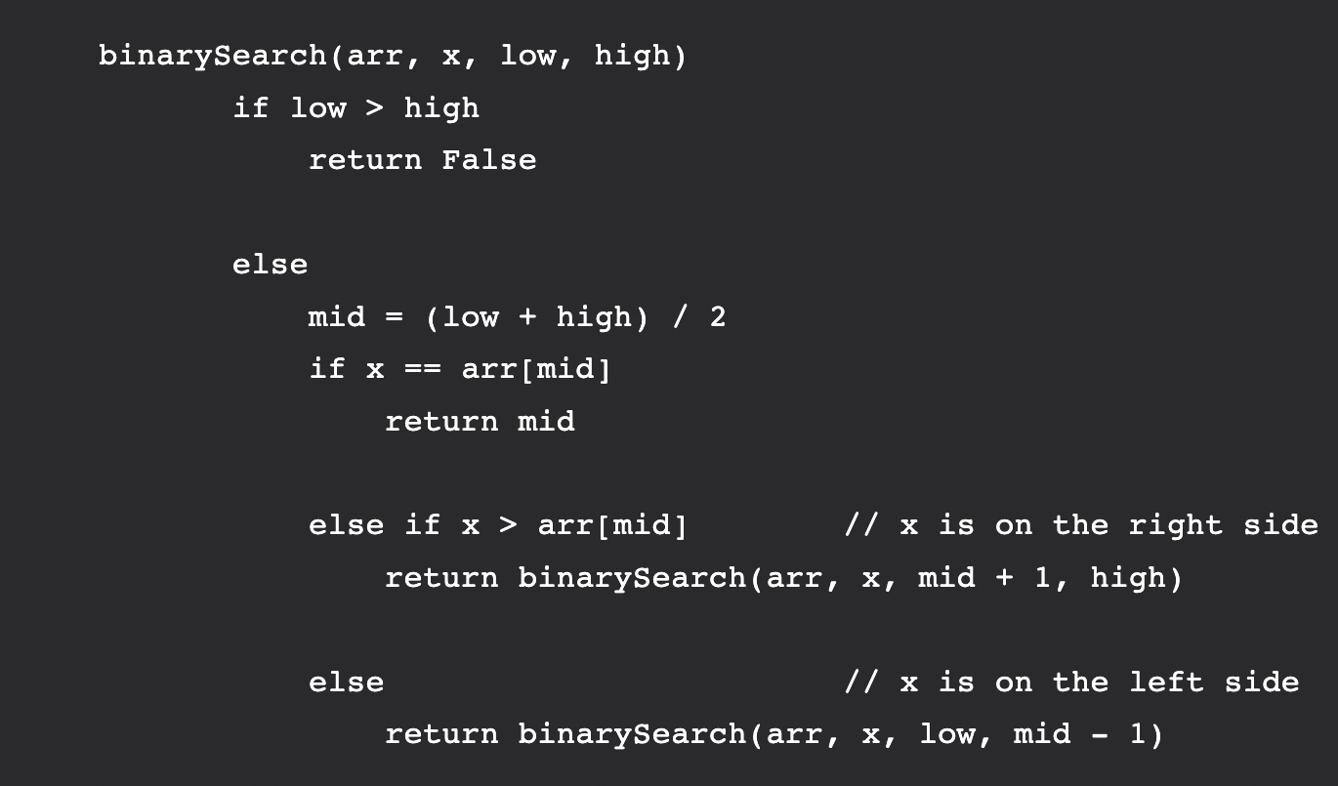
Recursive Method (The recursive method follows the divide and conquer approach)

Slide 128
Python implementation: Recursive implementation of Binary Search
def binarySearch(arr, l, r, x):
# Check base case
if r >= l:
mid = l + (r - l) // 2
# If element is present at the middle itself
if arr[mid] == x:
return mid
# If element is smaller than mid, then it
# can only be present in left subarray
elif arr[mid] > x:
return binarySearch(arr, l, mid-1, x)
# Else the element can only be present
# in right subarray
else:
return binarySearch(arr, mid + 1, r, x)
else:
# Element is not present in the array
return -1

Slide 129
# Driver Code
arr = [2, 3, 4, 10, 40]
x = 10
# Function call
result = binarySearch(arr, 0, len(arr)-1, x)
if result != -1:
print("Element is present at index % d" % result)
else:
print("Element is not present in array")
Time Complexity: O(log n) Auxiliary Space: O(log n)

Slide 130
Python implementation: Iterative Approach to Binary Search
def binarySearch(v, To_Find):
lo = 0
hi = len(v) - 1
# for mid=lo-(hi-lo)/2
while hi - lo > 1:
mid = (hi + lo) // 2
if v[mid] < To_Find:
lo = mid + 1
else:
hi = mid
if v[lo] == To_Find:
print("Found At Index", lo)
elif v[hi] == To_Find:
print("Found At Index", hi)
else:
print("Not Found")

Slide 131
if __name__ == '__main__':
v = [1, 3, 4, 5, 6]
To_Find = 1
binarySearch(v, To_Find)
To_Find = 6
binarySearch(v, To_Find)
To_Find = 10
binarySearch(v, To_Find)
Time Complexity: O (log n) Auxiliary Space: O (1)

Slide 132
Advantages of Binary Search:
Binary search is faster than linear search, especially for large arrays. As the size of the array increases, the time it takes to perform a linear search increases linearly, while the time it takes to perform a binary search increases logarithmically.
Binary search is more efficient than other searching algorithms that have a similar time complexity, such as interpolation search or exponential search.
Binary search is relatively simple to implement and easy to understand, making it a good choice for many applications.
Binary search can be used on both sorted arrays and sorted linked lists, making it a flexible algorithm.
Binary search is well-suited for searching large datasets that are stored in external memory, such as on a hard drive or in the cloud.
Binary search can be used as a building block for more complex algorithms, such as those used in computer graphics and machine learning.

Slide 133
Drawbacks of Binary Search:
We require the array to be sorted. If the array is not sorted, we must first sort it before performing the search. This adds an additional O(n log n) time complexity for the sorting step, which can make binary search less efficient for very small arrays.
Binary search requires that the array being searched be stored in contiguous memory locations. This can be a problem if the array is too large to fit in memory, or if the array is stored on external memory such as a hard drive or in the cloud.
Binary search requires that the elements of the array be comparable, meaning that they must be able to be ordered. This can be a problem if the elements of the array are not naturally ordered, or if the ordering is not well-defined.
Binary search can be less efficient than other algorithms, such as hash tables, for searching very large datasets that do not fit in memory.

Slide 134
Applications of Binary search:
Searching in machine learning: Binary search can be used as a building block for more complex algorithms used in machine learning, such as algorithms for training neural networks or finding the optimal hyperparameters for a model.
Commonly used in Competitive Programming.
Can be used for searching in computer graphics. Binary search can be used as a building block for more complex algorithms used in computer graphics, such as algorithms for ray tracing or texture mapping.
Can be used for searching a database. Binary search can be used to efficiently search a database of records, such as a customer database or a product catalog.

Slide 135
When to use Binary Search:
When searching a large dataset as it has a time complexity of O(log n), which means that it is much faster than linear search.
When the dataset is sorted.
When data is stored in contiguous memory.
Data does not have a complex structure or relationships.

Slide 136
Summary:
Binary search is an efficient algorithm for finding an element within a sorted array.
The time complexity of the binary search is O(log n).
One of the main drawbacks of binary search is that the array must be sorted.
Useful algorithm for building more complex algorithms in computer graphics and machine learning.

Slide 137
Sorting Techniques

Slide 138
Bubble Sort
Bubble sort is a sorting algorithm that compares two adjacent elements and swaps them until they are in the intended order.
Just like the movement of air bubbles in the water that rise up to the surface, each element of the array move to the end in each iteration. Therefore, it is called a bubble sort.

Slide 139
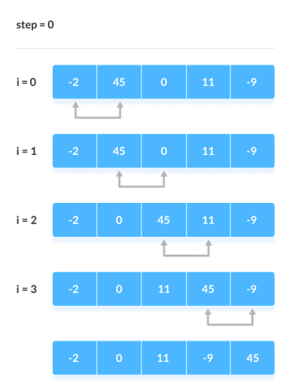
Working of Bubble Sort
Suppose we are trying to sort the elements in ascending order.
First Iteration (Compare and Swap)
Starting from the first index, compare the first and the second elements.
If the first element is greater than the second element, they are swapped.
Now, compare the second and the third elements. Swap them if they are not in order.
The above process goes on until the last element.

Slide 140
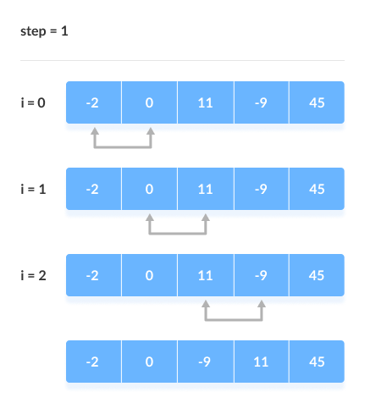
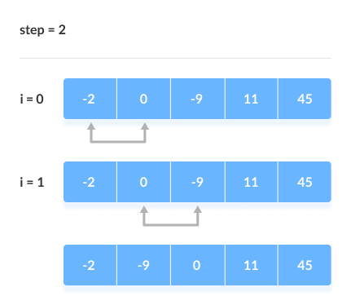
2. Remaining Iteration
The same process goes on for the remaining iterations.
After each iteration, the largest element among the unsorted elements is placed at the end.
In each iteration, the comparison takes place up to the last unsorted element.

Slide 141
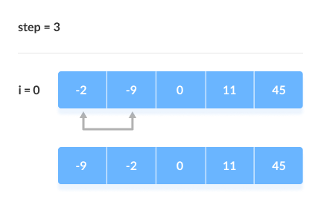
The array is sorted when all the unsorted elements are placed at their correct positions.

Slide 142
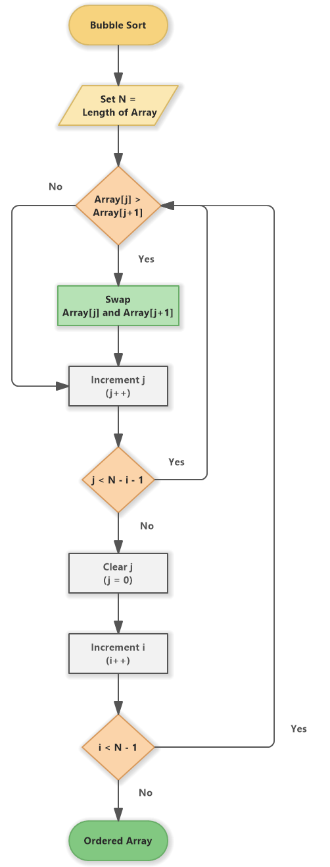
Bubble Sort Algorithm
bubbleSort(array)
for i <- 1 to indexOfLastUnsortedElement-1
if leftElement > rightElement
swap leftElement and rightElement
end bubbleSort

Slide 143
Bubble Sort Code in Python
def bubbleSort(array):
for i in range(len(array)):
for j in range(0, len(array) - i - 1):
if array[j] > array[j + 1]:
temp = array[j]
array[j] = array[j+1]
array[j+1] = temp
data = [-2, 45, 0, 11, -9]
Sorted_1 = bubbleSort(data)
print('Sorted Array in Ascending Order:', Sorted_1)

Slide 144
Optimized Bubble Sort Algorithm
In the above algorithm, all the comparisons are made even if the array is already sorted.
This increases the execution time.
To solve this, we can introduce an extra variable swapped. The value of swapped is set true if there occurs swapping of elements. Otherwise, it is set false.
After an iteration, if there is no swapping, the value of swapped will be false. This means elements are already sorted and there is no need to perform further iterations.
This will reduce the execution time and helps to optimize the bubble sort.

Slide 145
Optimized Bubble Sort in Python
def bubbleSort(array): for i in range(len(array)): # keep track of swapping swapped = False for j in range(0, len(array) - i - 1): if array[j] > array[j + 1]: temp = array[j] array[j] = array[j+1] array[j+1] = temp swapped = True # no swapping means the array is already sorted if not swapped: break
data = [-2, 45, 0, 11, -9]
Sorted_1 = bubbleSort(data) print('Sorted Array in Ascending Order:', Sorted_1)

Slide 146
Bubble Sort Complexity
Time Complexity
Best | O(n)
Worst | O(n2)
Average | O(n2)
Space Complexity | O(1)
Stability | Yes

Slide 147
Complexity in Detail
Bubble Sort compares the adjacent elements.
Cycle | Number of Comparisons
1st | (n-1)
2nd | (n-2)
3rd | (n-3)
....... | ......
last | 1
Hence, the number of comparisons is
(n-1) + (n-2) + (n-3) +.....+ 1 = n(n-1)/2, nearly equals to n2
Hence, Complexity: O(n2)
Also, if we observe the code, bubble sort requires two loops. Hence, the complexity is n*n = n2

Slide 148
1. Time Complexities
Worst Case Complexity: O(n2) If we want to sort in ascending order and the array is in descending order then the worst case occurs.
Best Case Complexity: O(n) If the array is already sorted, then there is no need for sorting.
Average Case Complexity: O(n2) It occurs when the elements of the array are in jumbled order (neither ascending nor descending).
2. Space Complexity
Space complexity is O(1) because an extra variable is used for swapping.
In the optimized bubble sort algorithm, two extra variables are used. Hence, the space complexity will be O(2).

Slide 149
Bubble Sort Applications
Bubble sort is used if
complexity does not matter
short and simple code is preferred

Slide 150
Selection Sort Algorithm

Slide 151
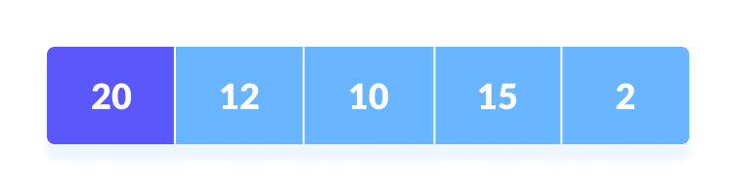
Selection sort is a sorting algorithm that selects the smallest element from an unsorted list in each iteration and places that element at the beginning of the unsorted list.
Working of Selection Sort
Set the first element as minimum.
Select first element as minimum​

Slide 152
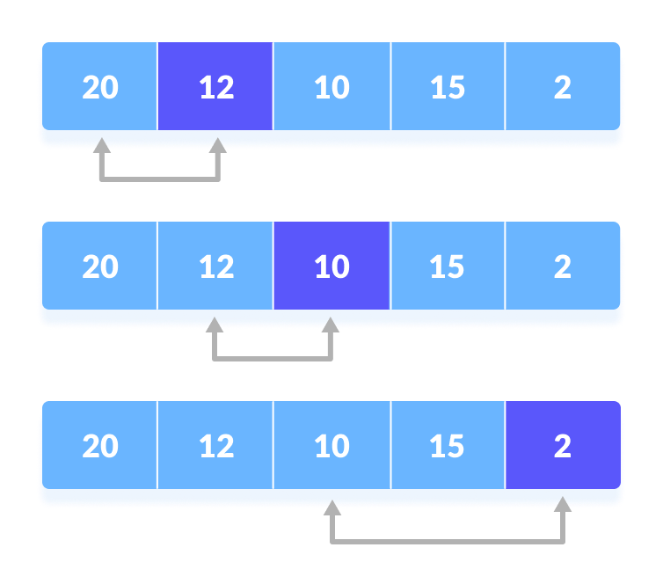
2. Compare minimum with the second element. If the second element is smaller than minimum, assign the second element as minimum. Compare minimum with the third element. Again, if the third element is smaller, then assign minimum to the third element otherwise do nothing. The process goes on until the last element.
Compare minimum with the remaining elements​

Slide 153
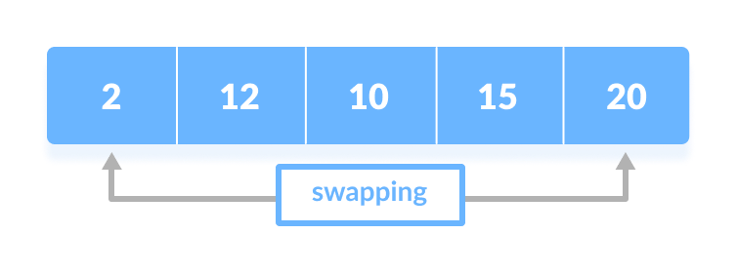
3. After each iteration, minimum is placed in the front of the unsorted list.
Swap the first with minimum​

Slide 154
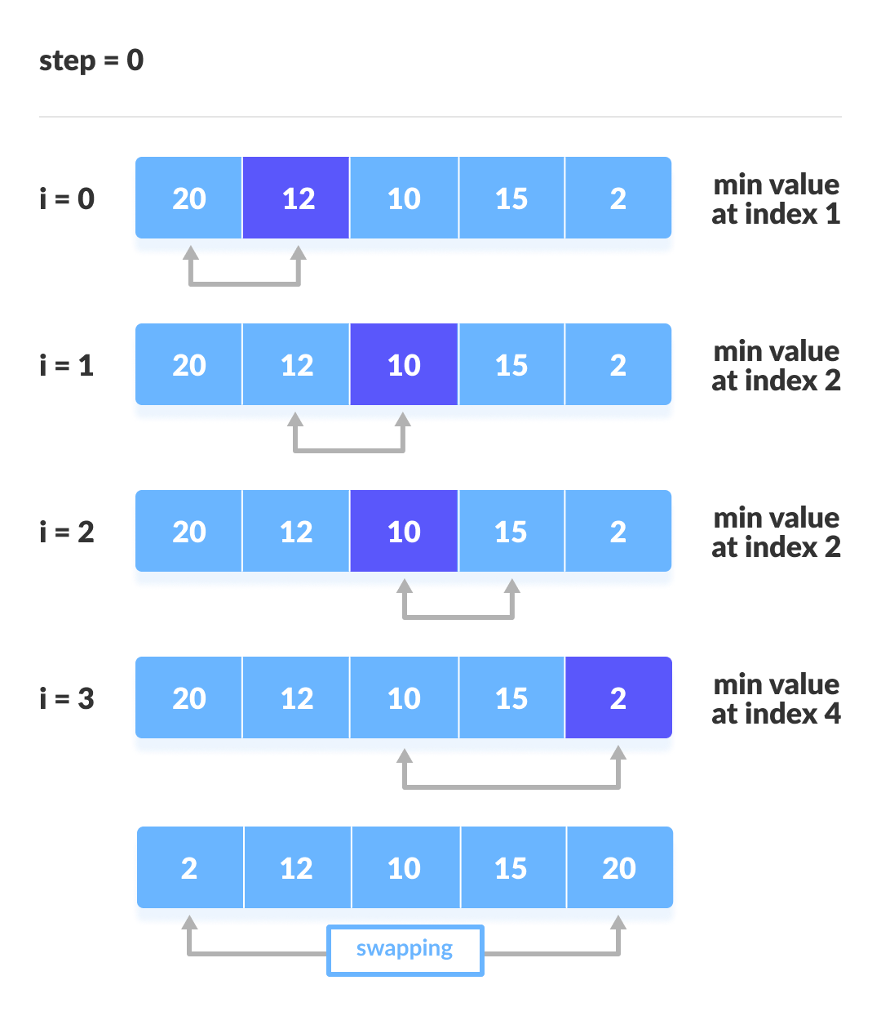
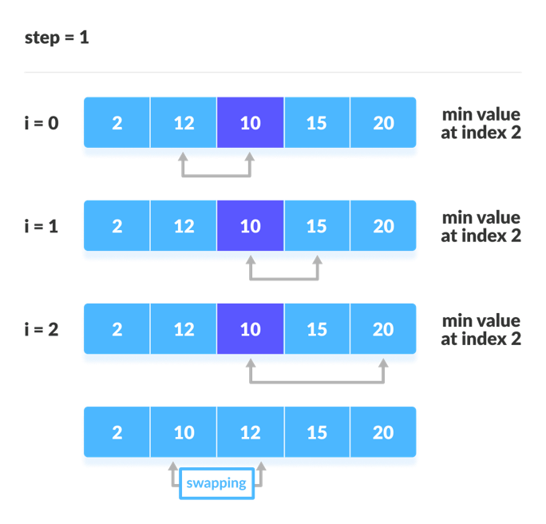
For each iteration, indexing starts from the first unsorted element. Step 1 to 3 are repeated until all the elements are placed at their correct positions.
The first iteration
The second iteration

Slide 155
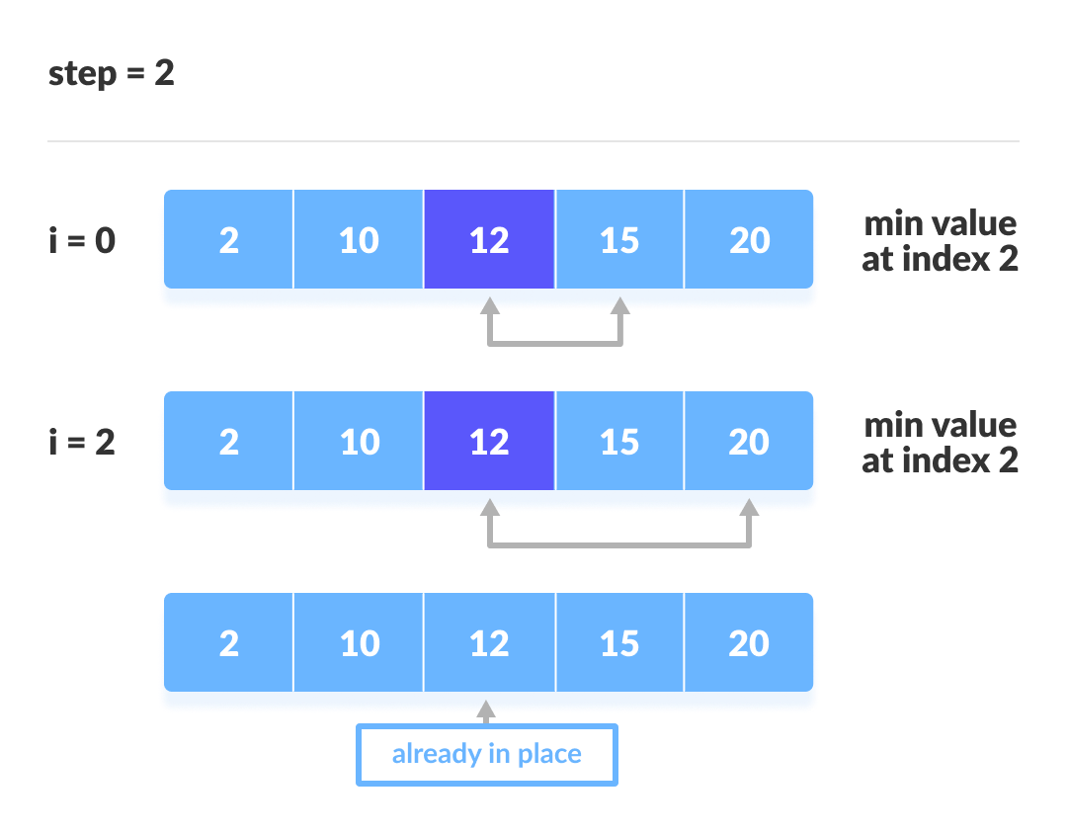
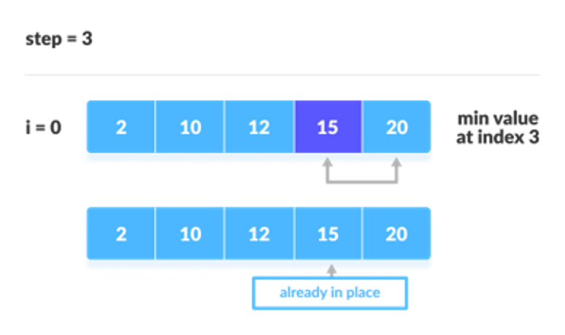
The fourth iteration
The third iteration

Slide 156
Selection Sort Algorithm
selectionSort(array, size)
repeat (size - 1) times
set the first unsorted element as the minimum for each of the unsorted elements
if element < currentMinimum
set element as new minimum
swap minimum with first unsorted position
end selectionSort

Slide 157
Selection Sort Code in Python
def selectionSort(array, size):
for step in range(size):
min_idx = step
for i in range(step + 1, size):
if array[i] < array[min_idx]:
min_idx = i
# put min at the correct position
(array[step],array[min_idx]) = (array[min_idx], array[step])
data = [-2, 45, 0, 11, -9]
size = len(data)
Se_sorted = selectionSort(data, size)
print('Sorted Array in Ascending Order:', Se_sorted)

Slide 158
Selection Sort Complexity
Time Complexity
Best | O(n2)
Worst | O(n2)
Average | O(n2)
Space Complexity | O(1)
Stability | No

Slide 159
Selection Sort Applications
The selection sort is used when
a small list is to be sorted
cost of swapping does not matter
checking of all the elements is compulsory
cost of writing to a memory matters like in flash memory (number of writes/swaps is O(n) as compared to O(n2) of bubble sort)

Slide 160
Insertion Sort Algorithm
Insertion sort is a sorting algorithm that places an unsorted element at its suitable place in each iteration.
Insertion sort works similarly as we sort cards in our hand in a card game.
We assume that the first card is already sorted then, we select an unsorted card. If the unsorted card is greater than the card in hand, it is placed on the right otherwise, to the left. In the same way, other unsorted cards are taken and put in their right place.

Slide 161
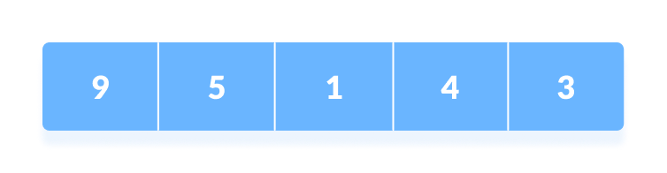
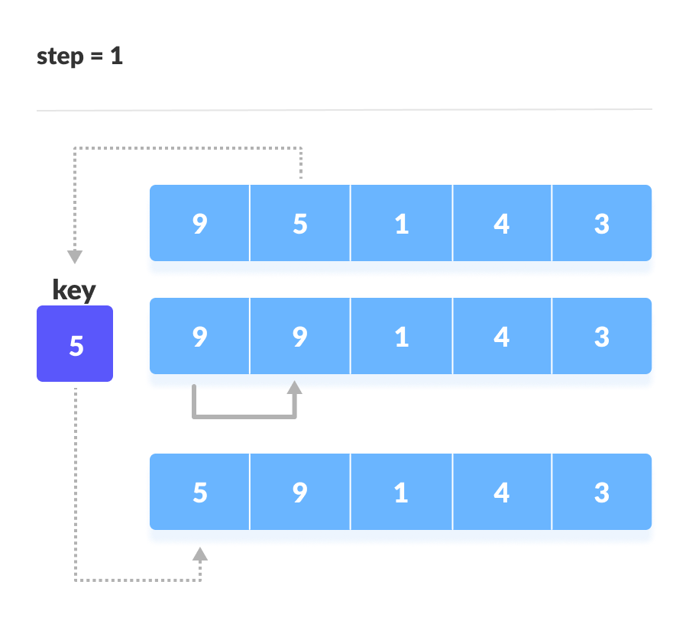
Working of Insertion Sort
Suppose we need to sort the following array.
Initial array
The first element in the array is assumed to be sorted. Take the second element and store it separately in key. Compare key with the first element. If the first element is greater than key, then key is placed in front of the first element.
If the first element is greater than key, then key is placed in front of the first element.

Slide 162
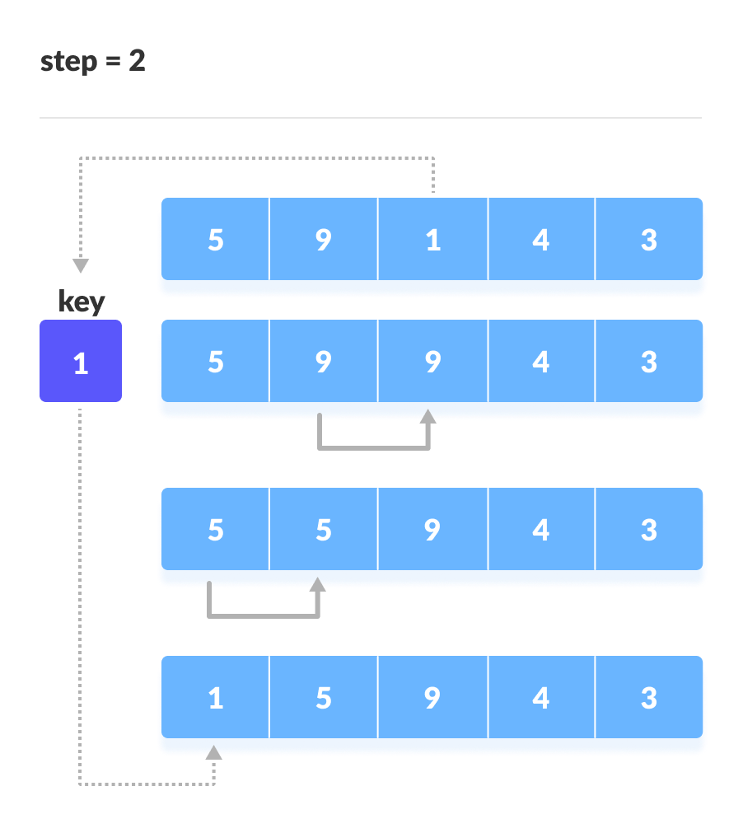
2. Now, the first two elements are sorted. Take the third element and compare it the elements on the left of it. Placed it just behind the element smaller than it. If there is no element smaller than it, then place it at the beginning of the array.
Place 1 at the beginning

Slide 163
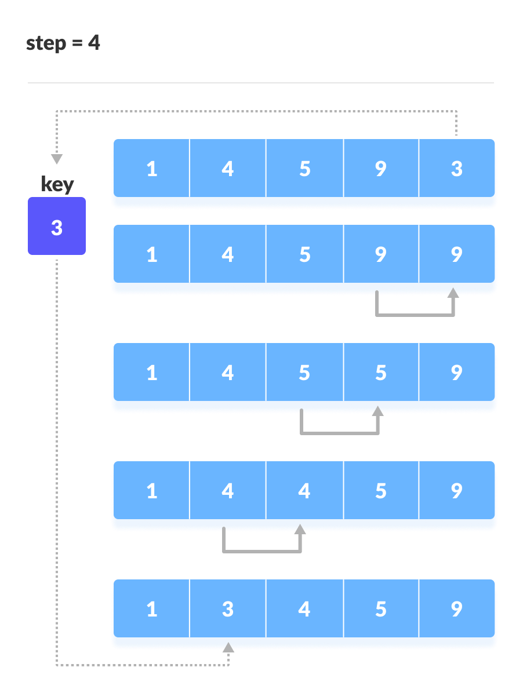

3. Similarly, place every unsorted element at its correct position.
Place 4 behind 1
Place 3 behind 1 and the array is sorted

Slide 164
Insertion Sort in Python
def insertionSort(array): for step in range(1, len(array)): key = array[step] j = step - 1 while j >= 0 and key < array[j]: array[j + 1] = array[j] j = j - 1 array[j + 1] = key
data = [9, 5, 1, 4, 3] In_sorted = insertionSort(data) print('Sorted Array in Ascending Order:', In_sorted)

Slide 165
Insertion Sort Complexity
Time Complexity
Best | O(n)
Worst | O(n2)
Average | O(n2)
Space Complexity | O(1)
Stability | Yes
Insertion Sort Applications
The insertion sort is used when:
the array is has a small number of elements
there are only a few elements left to be sorted

Slide 166
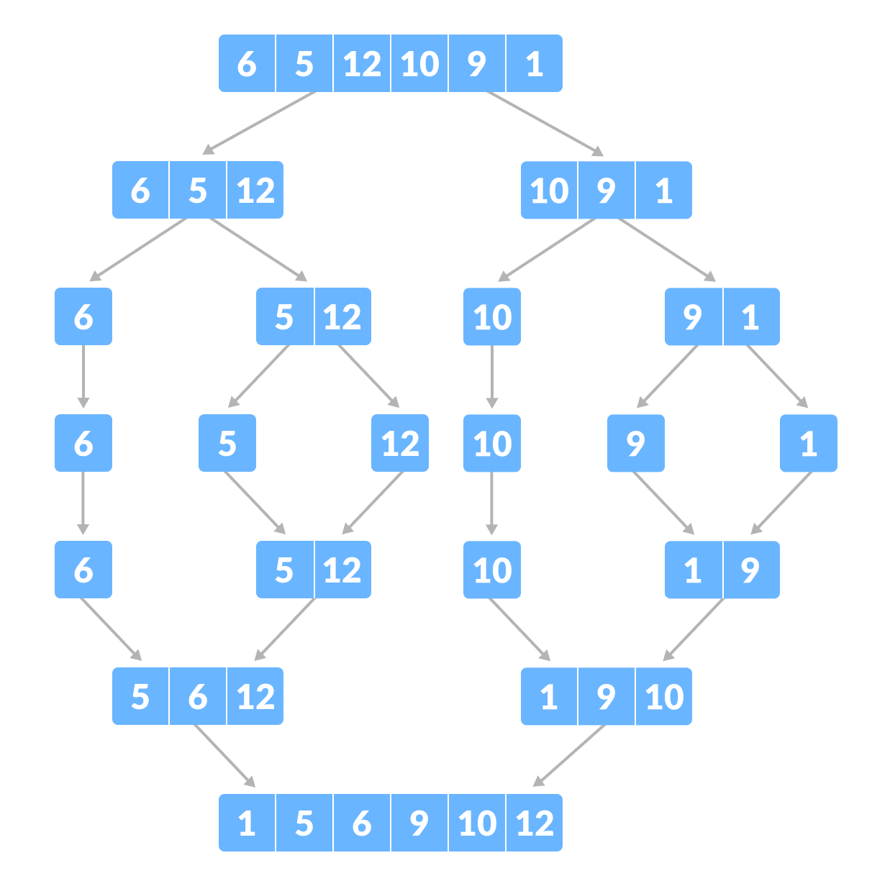
Merge Sort Algorithm
Merge Sort is based on the principle of Divide and Conquer Algorithm.
Here, a problem is divided into multiple sub-problems. Each sub-problem is solved individually. Finally, sub-problems are combined to form the final solution.

Slide 167
Divide and Conquer Strategy
Using the Divide and Conquer technique, we divide a problem into subproblems. When the solution to each subproblem is ready, we 'combine' the results from the subproblems to solve the main problem.
Suppose we had to sort an array A. A subproblem would be to sort a sub-section of this array starting at index p and ending at index r, denoted as A[p..r].
Divide
If q is the half-way point between p and r, then we can split the subarray A[p..r] into two arrays A[p..q] and A[q+1, r].
Conquer
In the conquer step, we try to sort both the subarrays A[p..q] and A[q+1, r]. If we haven't yet reached the base case, we again divide both these subarrays and try to sort them.
Combine
When the conquer step reaches the base step and we get two sorted subarrays A[p..q] and A[q+1, r] for array A[p..r], we combine the results by creating a sorted array A[p..r] from two sorted subarrays A[p..q] and A[q+1, r].

Slide 168
MergeSort Algorithm
The MergeSort function repeatedly divides the array into two halves until we reach a stage where we try to perform MergeSort on a subarray of size 1 i.e. p == r.
After that, the merge function comes into play and combines the sorted arrays into larger arrays until the whole array is merged.
MergeSort(A, p, r):
if p > r
return
q = (p+r)/2
mergeSort(A, p, q)
mergeSort(A, q+1, r)
merge(A, p, q, r)

Slide 169
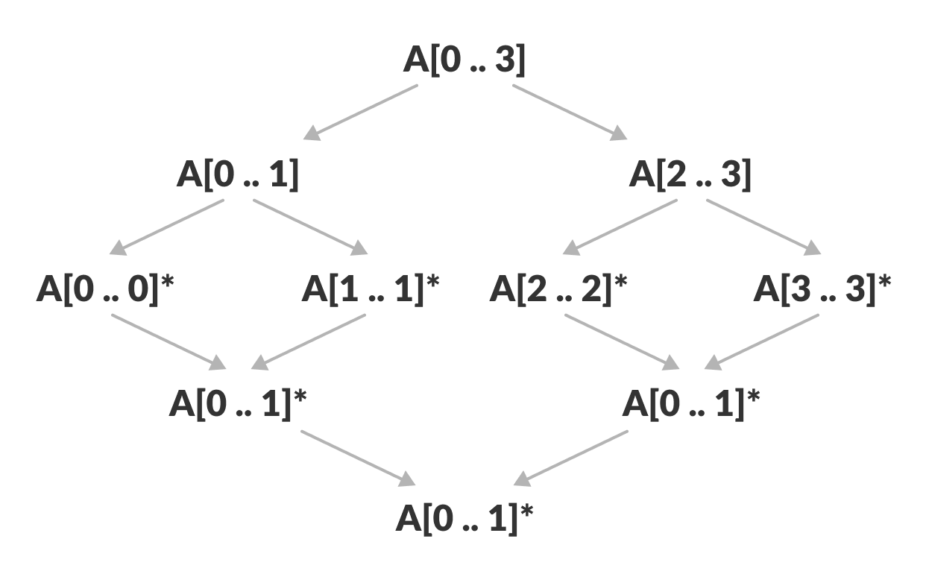
To sort an entire array, we need to call
MergeSort(A, 0, length(A)-1).
As shown in the image below, the merge sort algorithm recursively divides the array into halves until we reach the base case of array with 1 element. After that, the merge function picks up the sorted sub-arrays and merges them to gradually sort the entire array.

Slide 170
The merge Step of Merge Sort
Every recursive algorithm is dependent on a base case and the ability to combine the results from base cases. Merge sort is no different. The most important part of the merge sort algorithm is, you guessed it, merge step.
The merge step is the solution to the simple problem of merging two sorted lists(arrays) to build one large sorted list(array).
The algorithm maintains three pointers, one for each of the two arrays and one for maintaining the current index of the final sorted array.

Slide 171
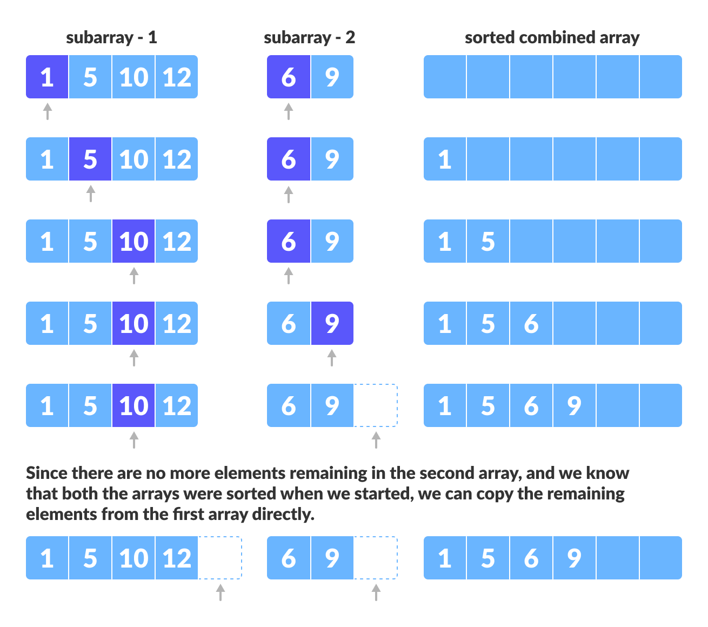

Slide 172
Writing the Code for Merge Algorithm
Our task is to merge two subarrays A[p..q] and A[q+1..r] to create a sorted array A[p..r]. So the inputs to the function are A, p, q and r
The merge function works as follows:
Create copies of the subarrays L <- A[p..q] and M <- A[q+1..r].
Create three pointers i, j and k
i maintains current index of L, starting at 1
j maintains current index of M, starting at 1
k maintains the current index of A[p..q], starting at p.
Until we reach the end of either L or M, pick the larger among the elements from L and M and place them in the correct position at A[p..q]
When we run out of elements in either L or M, pick up the remaining elements and put in A[p..q]

Slide 173
Merge Sort Code in Python
while i < len(L):
array[k] = L[i]
i += 1
k += 1
while j < len(M):
array[k] = M[j]
j += 1
k += 1
def mergeSort(array): if len(array) > 1: r = len(array)//2 L = array[:r] M = array[r:] mergeSort(L) mergeSort(M) i = j = k = 0 while i < len(L) and j < len(M): if L[i] < M[j]: array[k] = L[i] i += 1 else: array[k] = M[j] j += 1 k += 1
# Print the array
def printList(array):
for i in range(len(array)):
print(array[i], end=" ")
print()
# Driver program
if __name__ == '__main__':
array = [6, 5, 12, 10, 9, 1] mergeSort(array)
print("Sorted array is: ", array)

Slide 174
Merge Sort Complexity
Time Complexity
Best | O(n*log n)
Worst | O(n*log n)
Average | O(n*log n)
Space Complexity | O(n)
Stability | Yes
Merge Sort Applications
Inversion count problem
External sorting
E-commerce applications

Slide 175
Quicksort Algorithm
Quicksort is a sorting algorithm based on the divide and conquer approach where
An array is divided into subarrays by selecting a pivot element (element selected from the array). While dividing the array, the pivot element should be positioned in such a way that elements less than pivot are kept on the left side and elements greater than pivot are on the right side of the pivot.
The left and right subarrays are also divided using the same approach. This process continues until each subarray contains a single element.
At this point, elements are already sorted. Finally, elements are combined to form a sorted array.

Slide 176
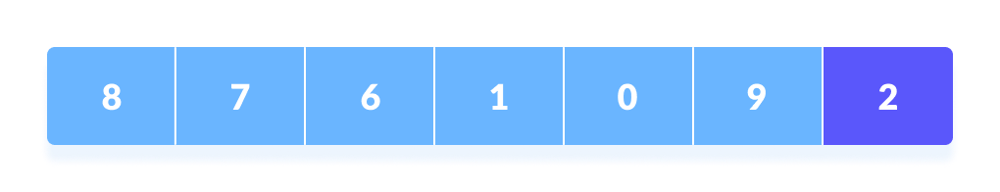
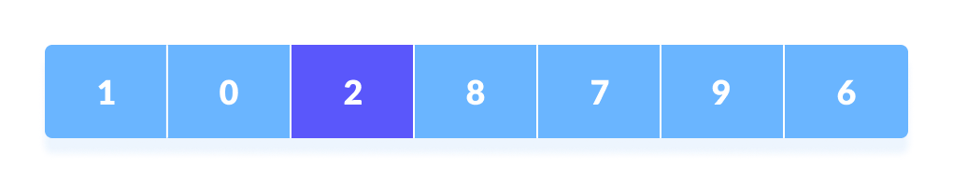
Working of Quicksort Algorithm
1. Select the Pivot Element
There are different variations of quicksort where the pivot element is selected from different positions. Here, we will be selecting the rightmost element of the array as the pivot element.
Select a pivot element
2. Rearrange the Array
Now the elements of the array are rearranged so that elements that are smaller than the pivot are put on the left and the elements greater than the pivot are put on the right.
Put all the smaller elements on the left and greater on the right of pivot element

Slide 177
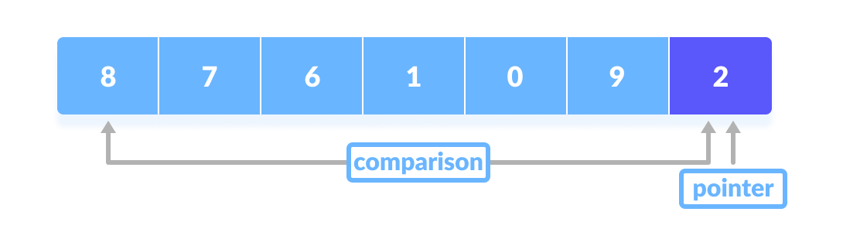
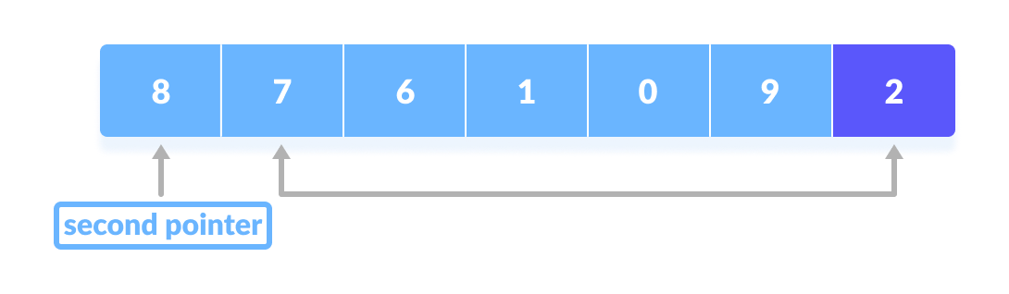
Here's how we rearrange the array:
A pointer is fixed at the pivot element. The pivot element is compared with the elements beginning from the first index.
If the element is greater than the pivot element, a second pointer is set for that element.
Comparison of pivot element with element beginning from the first index
If the element is greater than the pivot element, a second pointer is set for that element.​

Slide 178
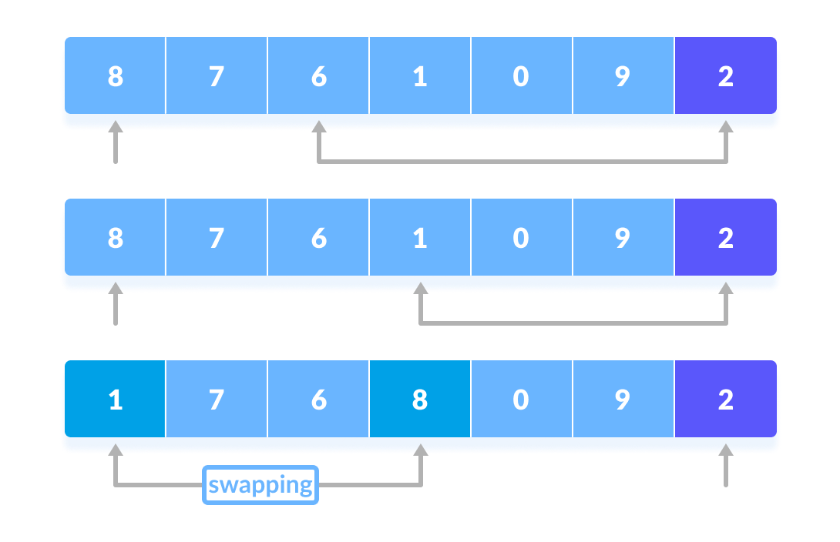
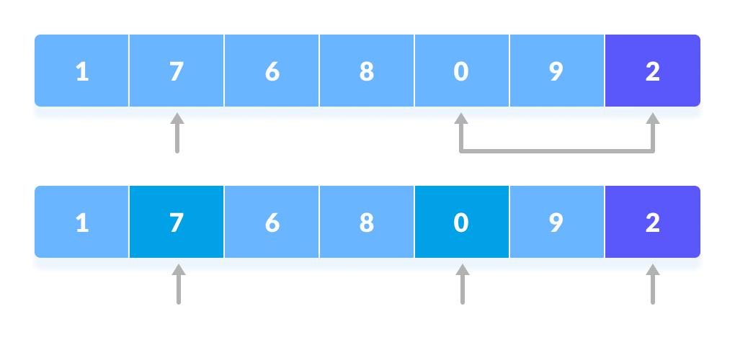
Now, pivot is compared with other elements. If an element smaller than the pivot element is reached, the smaller element is swapped with the greater element found earlier.
Again, the process is repeated to set the next greater element as the second pointer. And, swap it with another smaller element.
The process is repeated to set the next greater element as the second pointer.
Pivot is compared with other elements.​

Slide 179
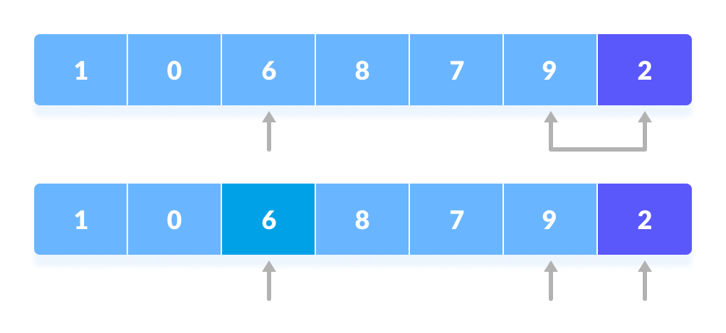
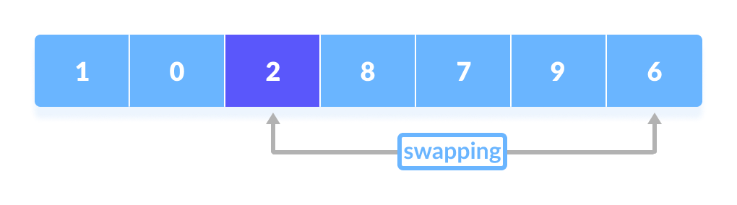
The process goes on until the second last element is reached.
Finally, the pivot element is swapped with the second pointer.

Slide 180
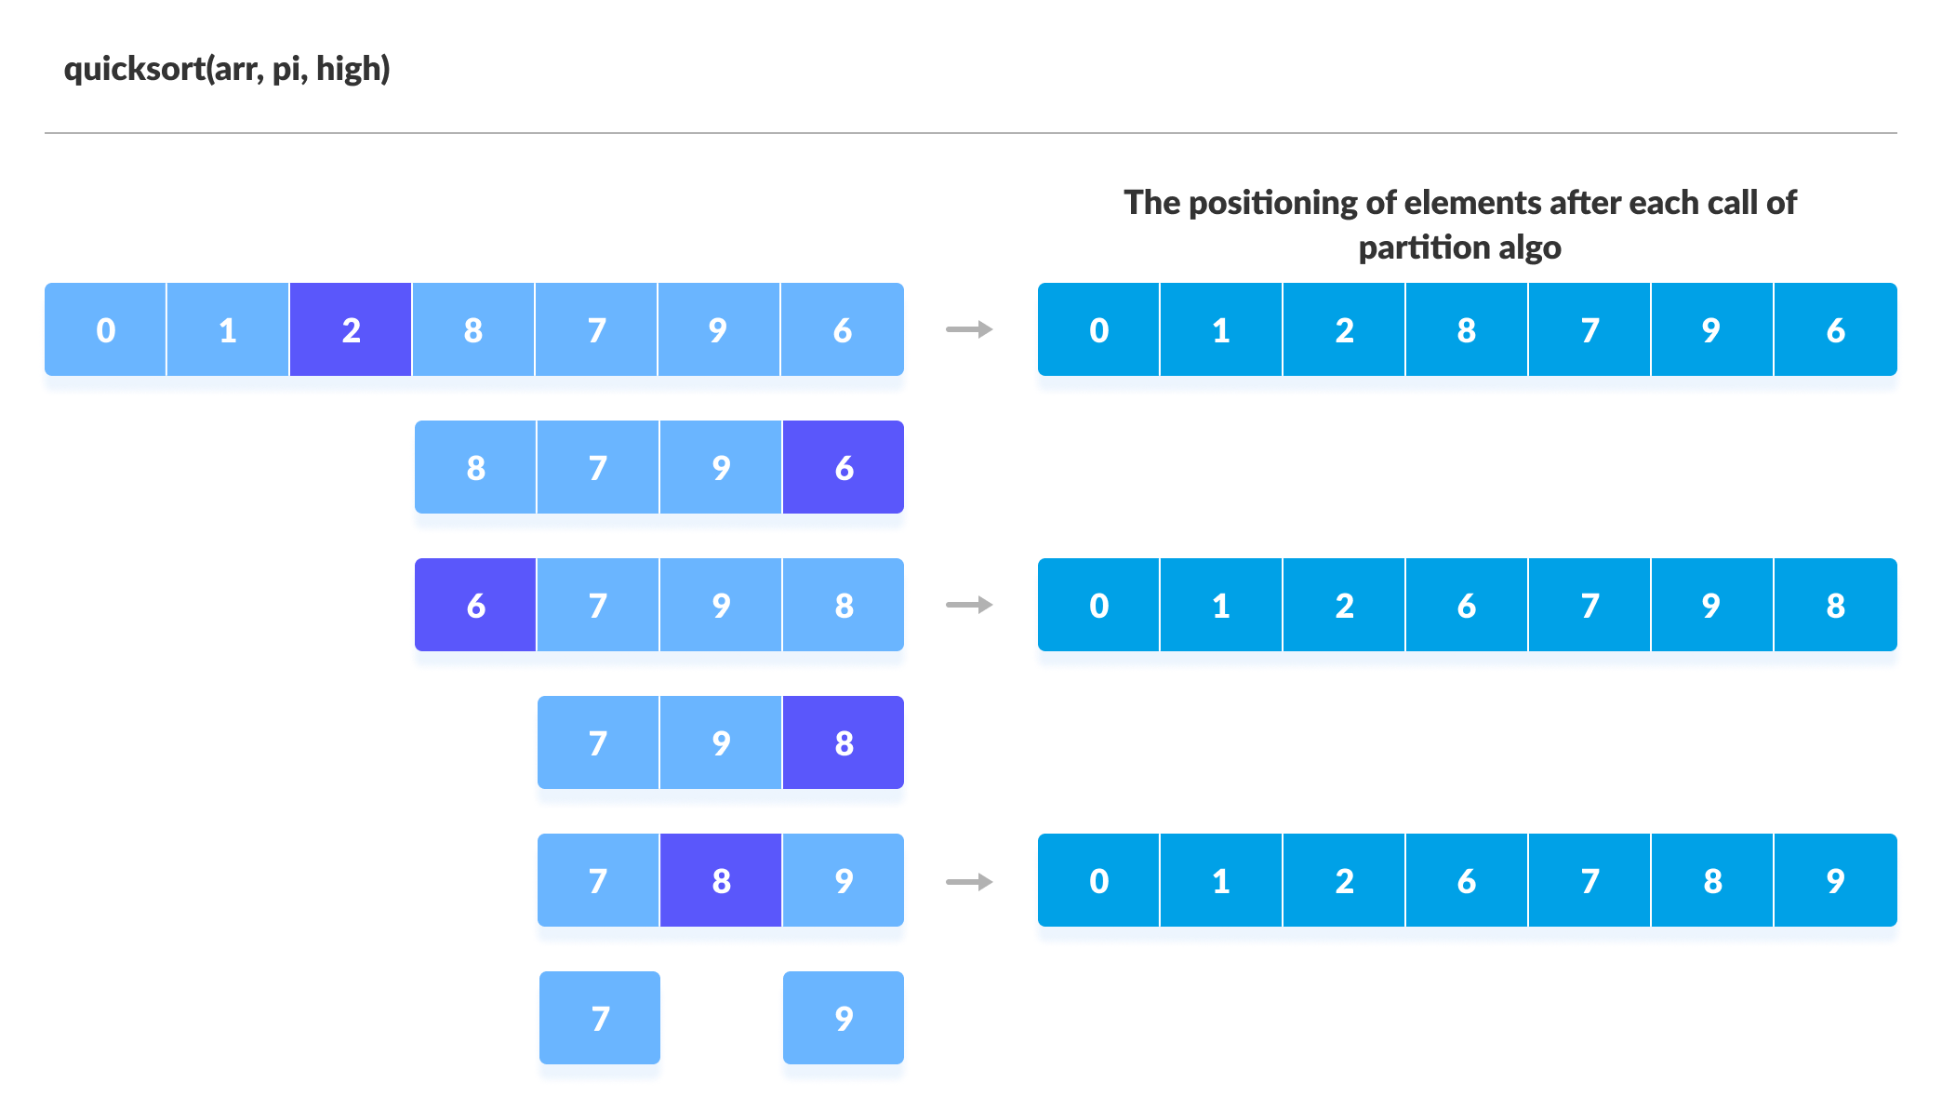
3. Divide Subarrays
Pivot elements are again chosen for the left and the right sub-parts separately. And, step 2 is repeated.
The subarrays are divided until each subarray is formed of a single element. At this point, the array is already sorted.
Select pivot element of in each half and put at correct place using recursion

Slide 181
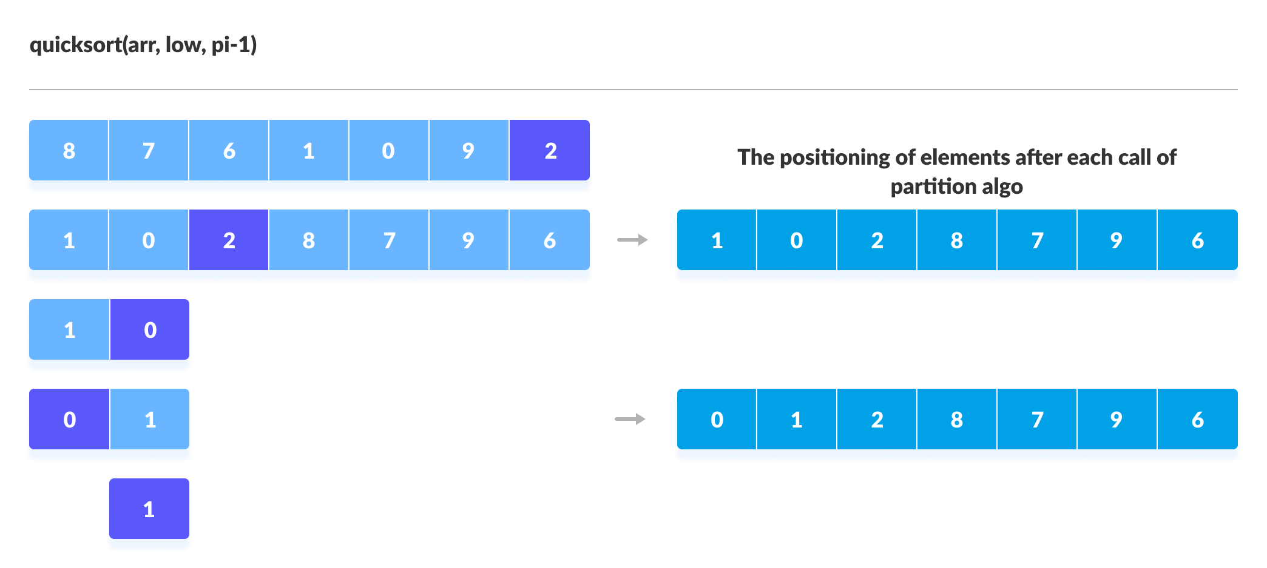

Visual Illustration of Quicksort Algorithm
Sorting the elements on the left of pivot using recursion
Sorting the elements on the right of pivot using recursion

Slide 182
Quicksort Code in Python
def partition(array, low, high): # choose the rightmost element as pivot pivot = array[high] # pointer for greater element i = low - 1 # traverse through all elements # compare each element with pivot for j in range(low, high): if array[j] <= pivot: # if element smaller than pivot is found # swap it with the greater element pointed by i i = i + 1 # swapping element at i with element at j (array[i], array[j]) = (array[j], array[i])

Slide 183
# swap the pivot element with the greater element specified by i​ (array[i + 1], array[high]) = (array[high], array[i + 1])​ ​ # return the position from where partition is done​ return i + 1
# function to perform quicksort​ def quickSort(array, low, high):​ if low < high:​ ​ # find pivot element such that​ # element smaller than pivot are on the left​ # element greater than pivot are on the right​ pi = partition(array, low, high)​ ​ # recursive call on the left of pivot​ quickSort(array, low, pi - 1)​ ​ # recursive call on the right of pivot​ quickSort(array, pi + 1, high)

Slide 184
data = [8, 7, 2, 1, 0, 9, 6] print("Unsorted Array") print(data) size = len(data) quickSort(data, 0, size - 1) print('Sorted Array in Ascending Order:') print(data)

Slide 185
Quicksort Complexity
Time Complexity
Best | O(n*log n)
Worst | O(n2)
Average | O(n*log n)
Space Complexity | O(log n)
Stability | No
Quicksort Applications
Quicksort algorithm is used when
the programming language is good for recursion
time complexity matters
space complexity matters

